Slide 1

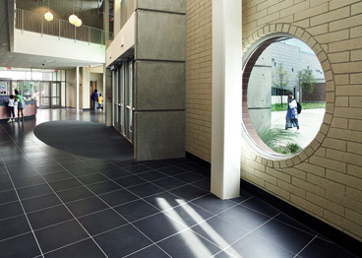

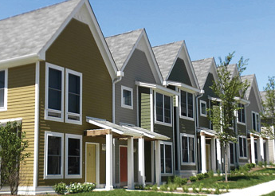

IFF – A Flexible Resource
The Midwest’s Leading Community Development
Financial Institution (CDFI)
  8.24.2021

Slide 2
Agenda
Introduction
Brief IFF Overview
Flexible Financing
Real Estate Project Support

Slide 3
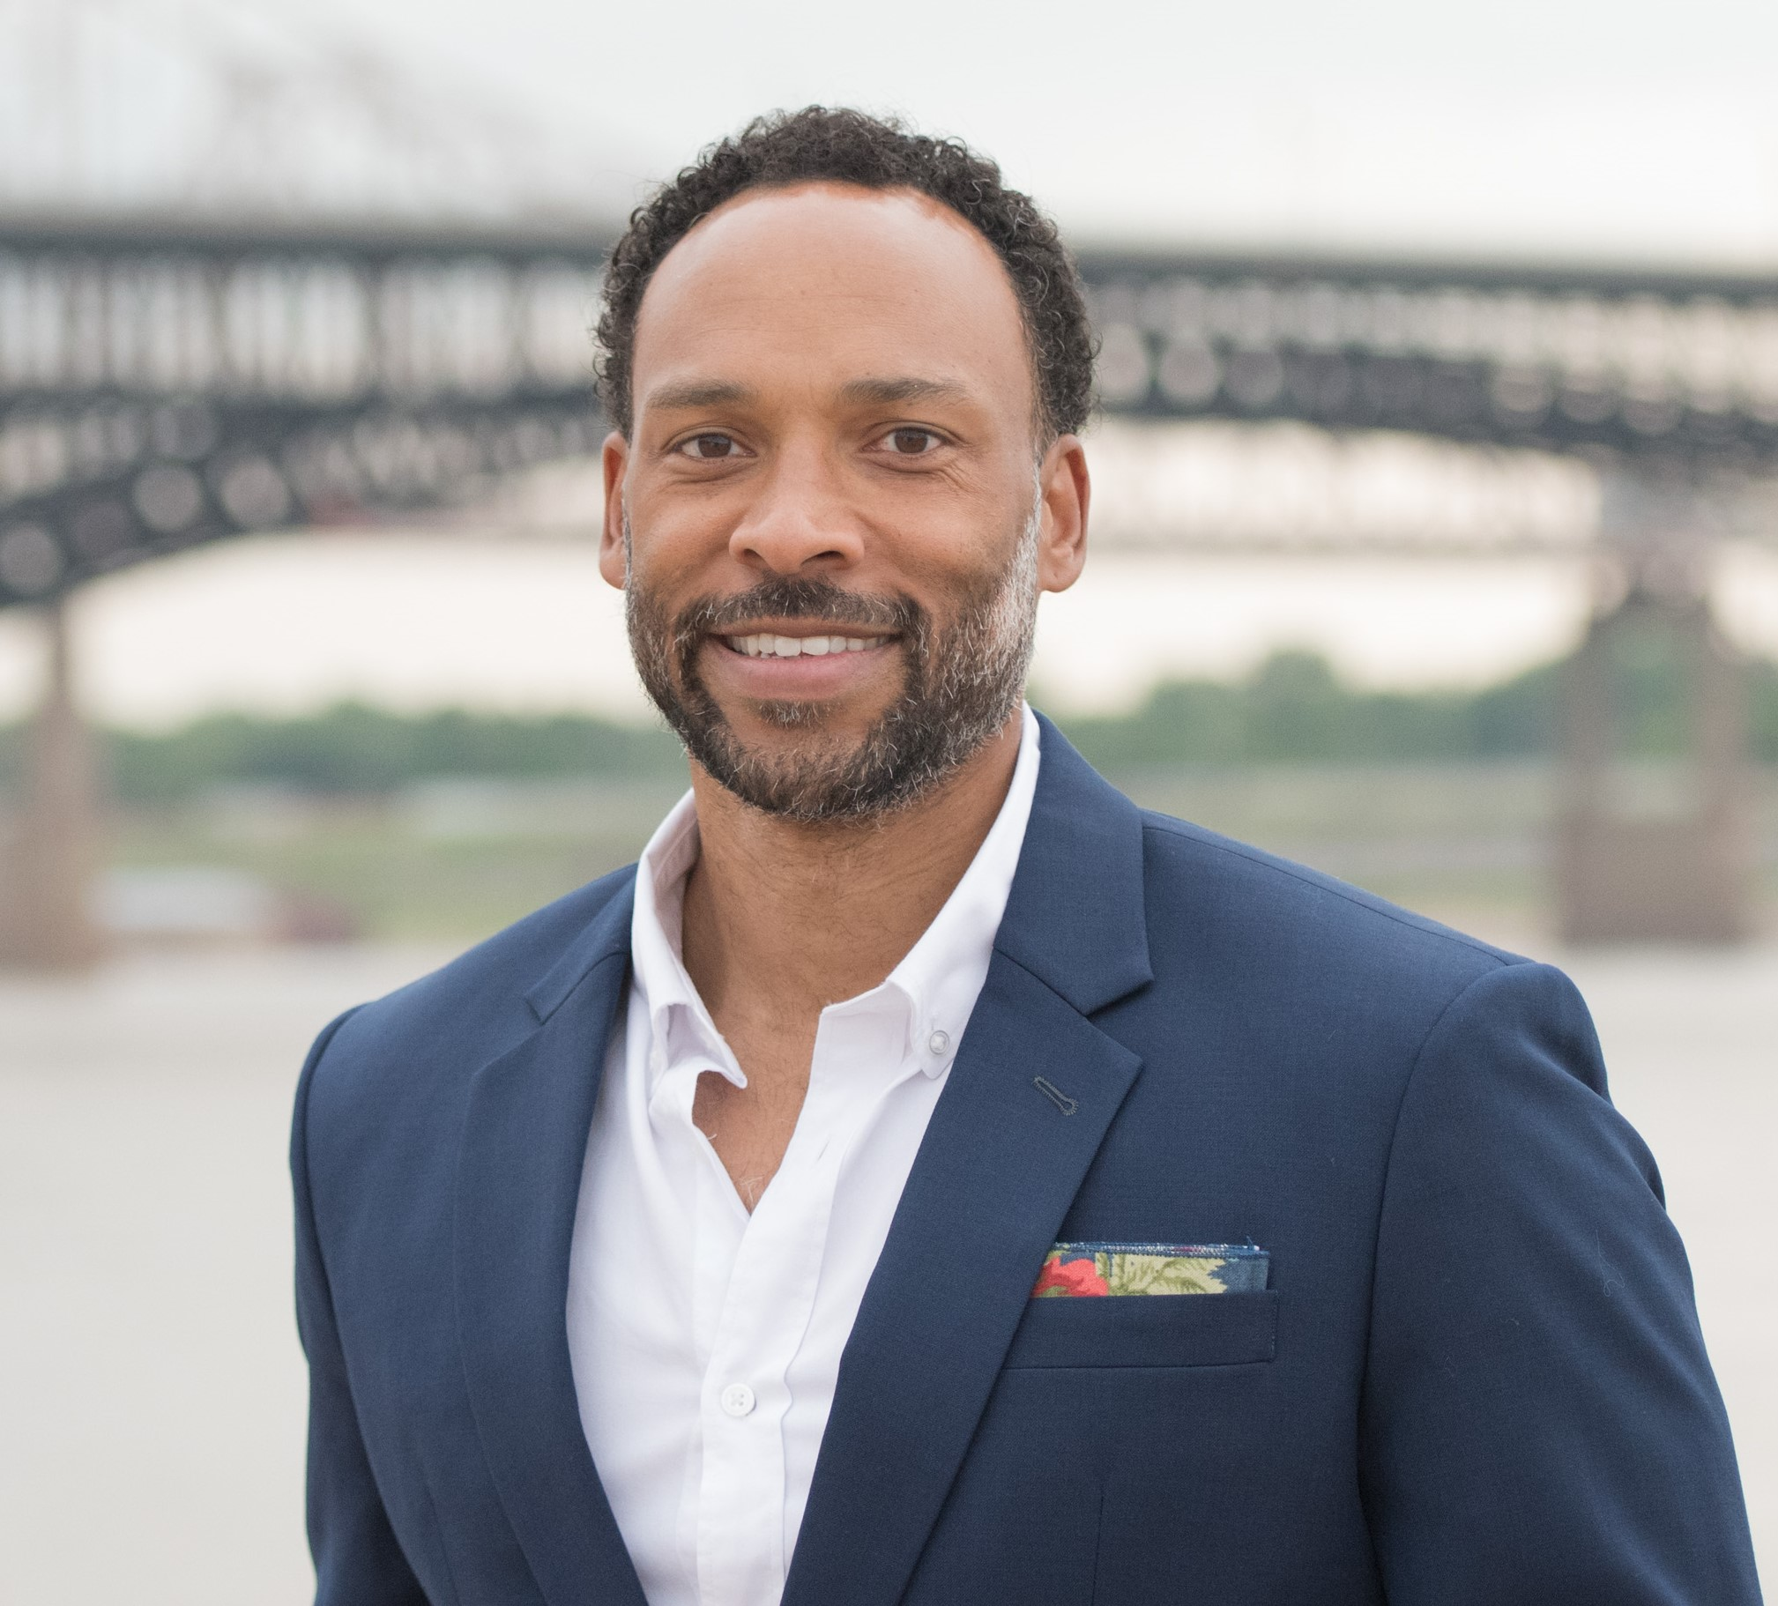

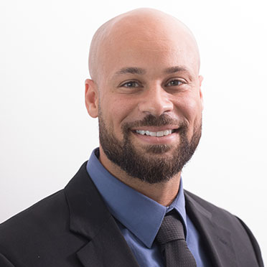
Stephen Westbrooks Executive Director – Southern Region
Cathy Hammer
Senior Lender
LaMar Miller
Director of Real Estate Solutions

Slide 4
IFF is a CDFI…… +
Community Development Financial Institutions (CDFIs) are US Treasury-certified organizations that provide financing targeted to disinvested communities. 4 types:
Banks—For-profit depository corporations providing capital to rebuild economically distressed communities through targeted lending and investments
Credit Unions—Member-owned non-profit cooperatives promoting savings, affordable loans, and other financial services
Loan Funds—Typically non-profit, non-depository organizations providing financing and technical assistance to small businesses, affordable housing developers, and community service organizations
Venture Capital Funds—Organizations providing equity and debt-with-equity services to businesses in distressed communities

Slide 5
+
CDFI
Real Estate Lending and Consulting
Social Impact Accelerator
Research & Evaluation
Development

Slide 6
+
CDFI
Real Estate Lending and Consulting
Social Impact Accelerator
Research & Evaluation
Development

Slide 7
Capital Solutions
Notes:
As a non profit lender, IFF values and understands other non profits in a way traditional lenders may have a tough time getting.
We value the non profits in our community and design solutions that help grow, build net assets and strengthen financial health.

Slide 8
Why IFF is Unique and Accessible to Non-Profits:
Non-appraisal-based lending
  No appraisals required for loans up to $3MM
Will loan up to 95% of costs
  IFF offers 15-year fully amortizing loans
Loan structures that prioritize client needs
  No prepayment penalties
Lending across all nonprofit industries
  Significant impact beyond affordable housing or education
Sterling track record for investors
  IFF has never lost a single dollar for investors
Notes:
IFF has offered non-appraisal based lending since our founding in 1988. IFF wants organizations to be able to grow stronger by providing financing for facilities critical to their mission.
IFF will loan up to 95% of costs. Common projects are facilities, capital improvements and equipment.
Facility loans include capital projects like acquisition, construction, renovation.
Capital improvements like roof repair and HVAC system.
Equipment and vehicle loans like computer hardware, medical equipment and service vehicles.
Loan structures prioritize what is in the best interest of the borrower.
IFF lends to all 501(c)(3) organizations.

Slide 9
IFF’s Work with Our Market – Humboldt, Kansas
In 2020, IFF supported Our Market with a $300K loan
Funded interior renovation and equipment purchase
Collateral for loan was a leasehold mortgage and UCC on equipment funded
Today, both butcher and grocery portions of Our Market are serving Allen County
Notes:
IFF works with NMTC, credit enhancements and affordable housing loans.
For example, Urban Sprouts received $2M of a NMTC allocation.

Slide 10
IFF’s Work with KidZone – Kansas City, Kansas
This year, IFF supported KidZone with a $1.1M loan
Supported refinance of existing bridge loan debt, underground water mitigation work and playground equipment purchase
Borrower valued 95% loan and no prepayment penalty
  Highlights IFF’s flexible lending capabilities
Notes:
Borrower appreciated 95% loan. CWT qualified for a conventional loan requiring convention LTV.
This borrower is working through acquisition inspection delays due to COVID 19, likely delaying acquisition. IFF understands and is committed to lending these funds when CWT is able to confirm this building is ready for turn key occupancy.

Slide 11
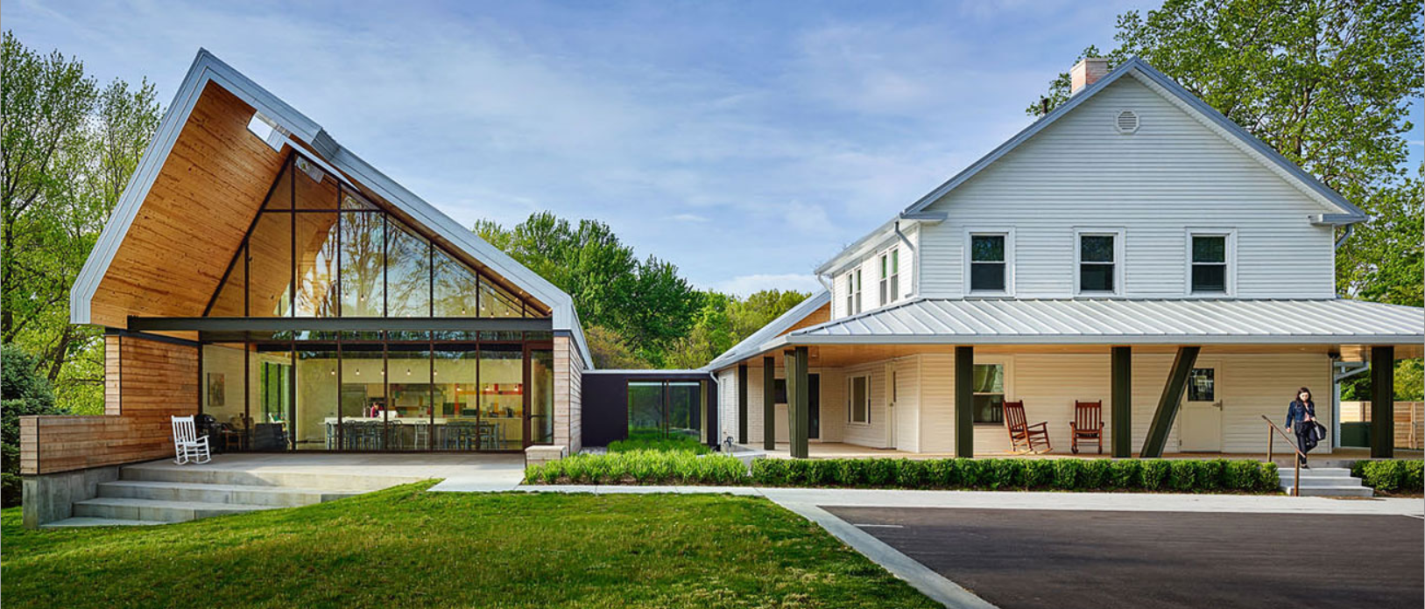
IFF’s Work with Synergy Services – Parkville, Missouri
In 2020, IFF supported Synergy Services with a $400K capital campaign bridge loan refinancing
Original terms were 3-year IO with balloon. Restructured to be 15 year fully amortizing.
Borrower valued 100% loan requiring no principal pay down.
  Highlights IFF’s flexible lending capabilities
Notes:
IFF will consider refinancing our debt or other lender’s debt. For example, Synergy Services wanted to pay their bridge loan over a longer period of time. By fixing their rate, Synergy improves their cash flow management.
Borrower appreciated a 100% refinance structure of IFF existing debt.

Slide 12
Real Estate Solutions

Slide 13
Are you or anyone you know…
Looking for or wanting to know if their current location is the right size, right location, right price, and the right plan for now and the future?
Would like to know what condition their current or future building is in and how much it would cost to repair or renovate?
Would like to know what’s the best use of dollars that would have the most impact when dealing with multiple facilities?
Would like assistance searching for a new location, negotiating a lease or purchase, knowing what questions to ask, what due diligence would make sense, and what contractors to hire?
Would like assistance assembling a development budget, hiring an architect, contractors, overseeing design and construction, navigating the permit process, and ensure the project get done on time and under budget?

Slide 14

Why IFF?

Slide 15
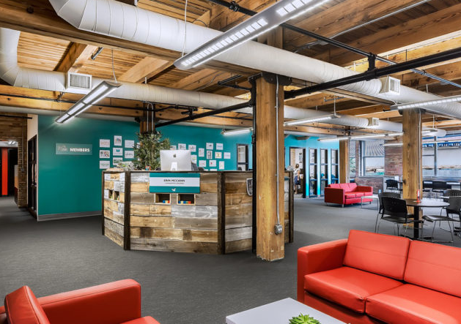
#1 - You are the expert of your field, and your job is difficult enough.
Our team is trained and experienced in disciplines from architecture, engineering, construction, and urban planning.
We work broadly across the nonprofit sector and have deep expertise in charter schools, childcare, housing, community development, health care, and human services.

Slide 16
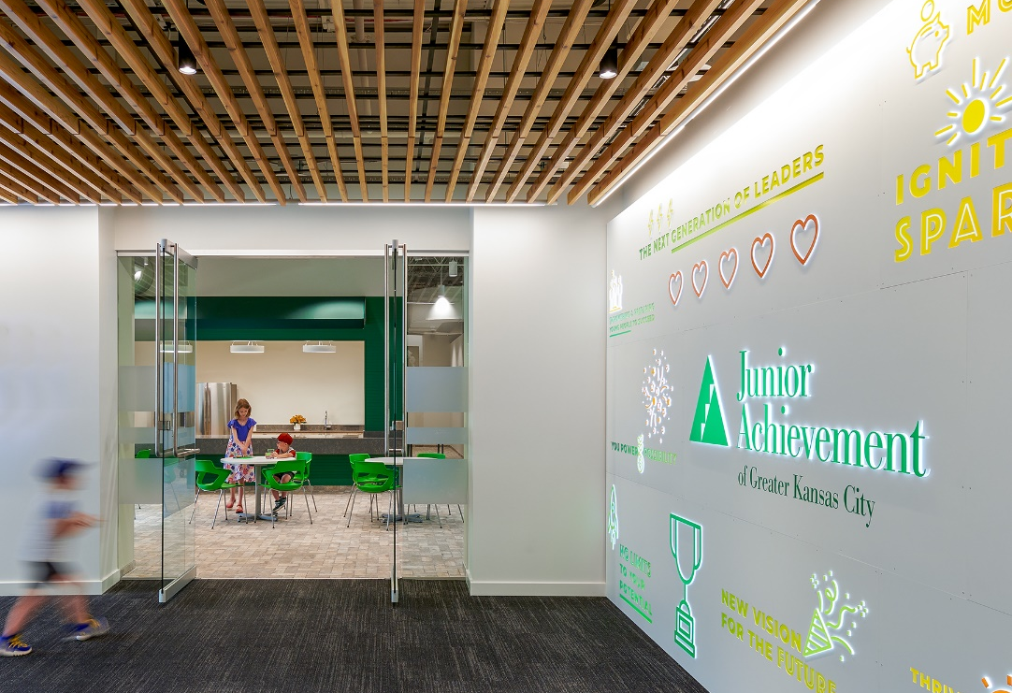
#2: Partnering with an experienced partner like IFF will save time, money, and headaches down the line by make more informed decisions.
IFF helps you:
Understand your options
Develop a plan that responds to your programmatic, financial, and real estate needs
A solid plan gives funders and lenders more confidence in the project, increasing your ability to raise capital for the project
Avoid backtracking and correcting for avoidable mistakes

Slide 17
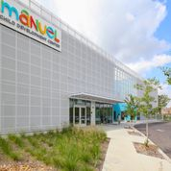
A floor plan for tomorrow
Delivering real estate services from early planning through ribbon cutting
Whether you are starting to plan for growth or preparing to find a new home for your organization, you can rely on IFF to guide you from initial project conception through the ribbon-cutting ceremony.

Slide 18
Stephen Westbrooks Executive Director – Southern Region
swestbrooks@iff.org
Cathy Hammer
Senior Lender
chammer@iff.org
LaMar Miller
Director of Real Estate Solutions
lmiller@iff.org

Slide 19
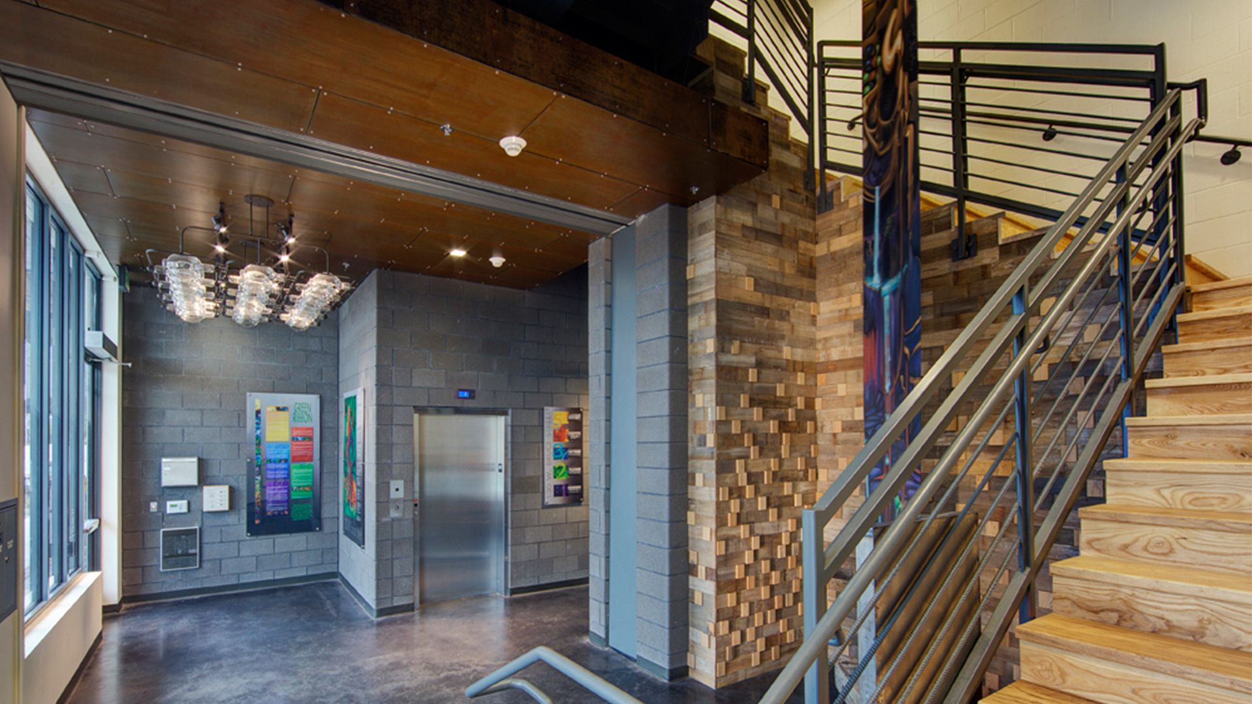
Questions?

