Slide 1
Kansas Healthy Food Initiative
Networked Convening
July 20, 2021
Kansas State Research & Extension
Kansas State University
Notes:
Dave

Slide 2
Background and Context
Dr. David Procter

Slide 3

The Kansas Healthy Food Initiative is a public-private partnership that aims to increase access to affordable healthy food to improve the health and economic development of Kansans and their communities.

Slide 4






Launched November 2017
Seeded by the Kansas Health Foundation
Provides technical assistance and financing to bring healthy foods to Kansans living in underserved, low-resource areas
Works to bridge informational and financing gaps faced by healthy food stakeholders and food retailers

Slide 5
As of March 2021:
22 projects approved for funding
727 Technical Assistance inquiries completed
35 unique counties served
85 jobs retained
133.5 jobs created
$13.59 Million leveraged
105,653 residents served
Notes:
NOTES:
In Q1 2021, 7 intake forms were received from 2 new counties (Jackson Co., Kansas and Howell Co., Missouri) and 4 repeat counties (Sedgwick-2 projects, McPherson, Russell, and Douglas)
3 new projects, and 1 repeat project (Tecklenberg), were approved for KHFI loan/grant funding in Q1 2021. Repeat project sites are not counted twice (e.g., in # sites, residents served, retail space expanded), but funding amounts are added to loan and grant $ totals
“Approved for Funding”: For evaluation purposes, projects “approved for funding” is counted when the KHFI Investment Committee makes a determination to fund the project with loans, grants or a combination. This differs from timing of funds being disbursed to applicants. As of Q1 2021, 25 out of 25 approved projects have received allocated grant and loan funding amounts.
Jobs: Approved Q1 2021 projects estimated a total of 15.5 jobs created and 7 jobs retained.
Leverage sources in Q1 2021: $240,000 Total; Hometown Market has a $200,000 bank loan and $25,000 owner investment; Tecklenberg has a $15,000 bank line of credit toward the project; This brings the total $ leveraged by KHFI funded projects to: $13,589,876.
# Residents Served (estimates based on figures from Policy Map): Definition of # Residents Served = population living in a 10-mile radius of a project location designated by USDA as “rural” (Hometown Market = 783), or in a 1-mile radius of a project location designated by USDA as urban (Common Ground = 7,948; and Pearson’s Farms = 1,495). Tecklenberg Farms received a 2nd round of grant funding in Q1 ’21; # of residents served is not double counted here since it was originally counted in Q1 ‘19. The total # of residents served by 3 new project sites approved in Q1 ‘21 is 10,226.
% Low Income Areas: the Kansas statewide rate of students approved for free & reduced lunch is 44.8% for the 2020-2021 school year. This compares to 55.3% of students in Sedgwick County where Common Ground and Pearson’s Farms are located, and to 53.6% of students in Cheyenne County where Hometown Market is located. Therefore, 100% of new project sites this quarter have County-level free and reduced lunch eligibility rates that are higher than the Kansas statewide rate of 44.8%. These KSDE data indicate that, respectively, 55.3% and 53.6% of families in the Common Ground / Pearson’s Farms and Hometown Market areas live at or below ≤185% of the federal poverty line (vs. 44.8% statewide). In total, 20 of 22 project sites approved for KHFI loan/grant financing (90.9%) are located in areas where free & reduced lunch eligibility rates are higher than the overall Kansas statewide rate. (This metric is not assessed for the 3 small t.a. only grants.)

Slide 6
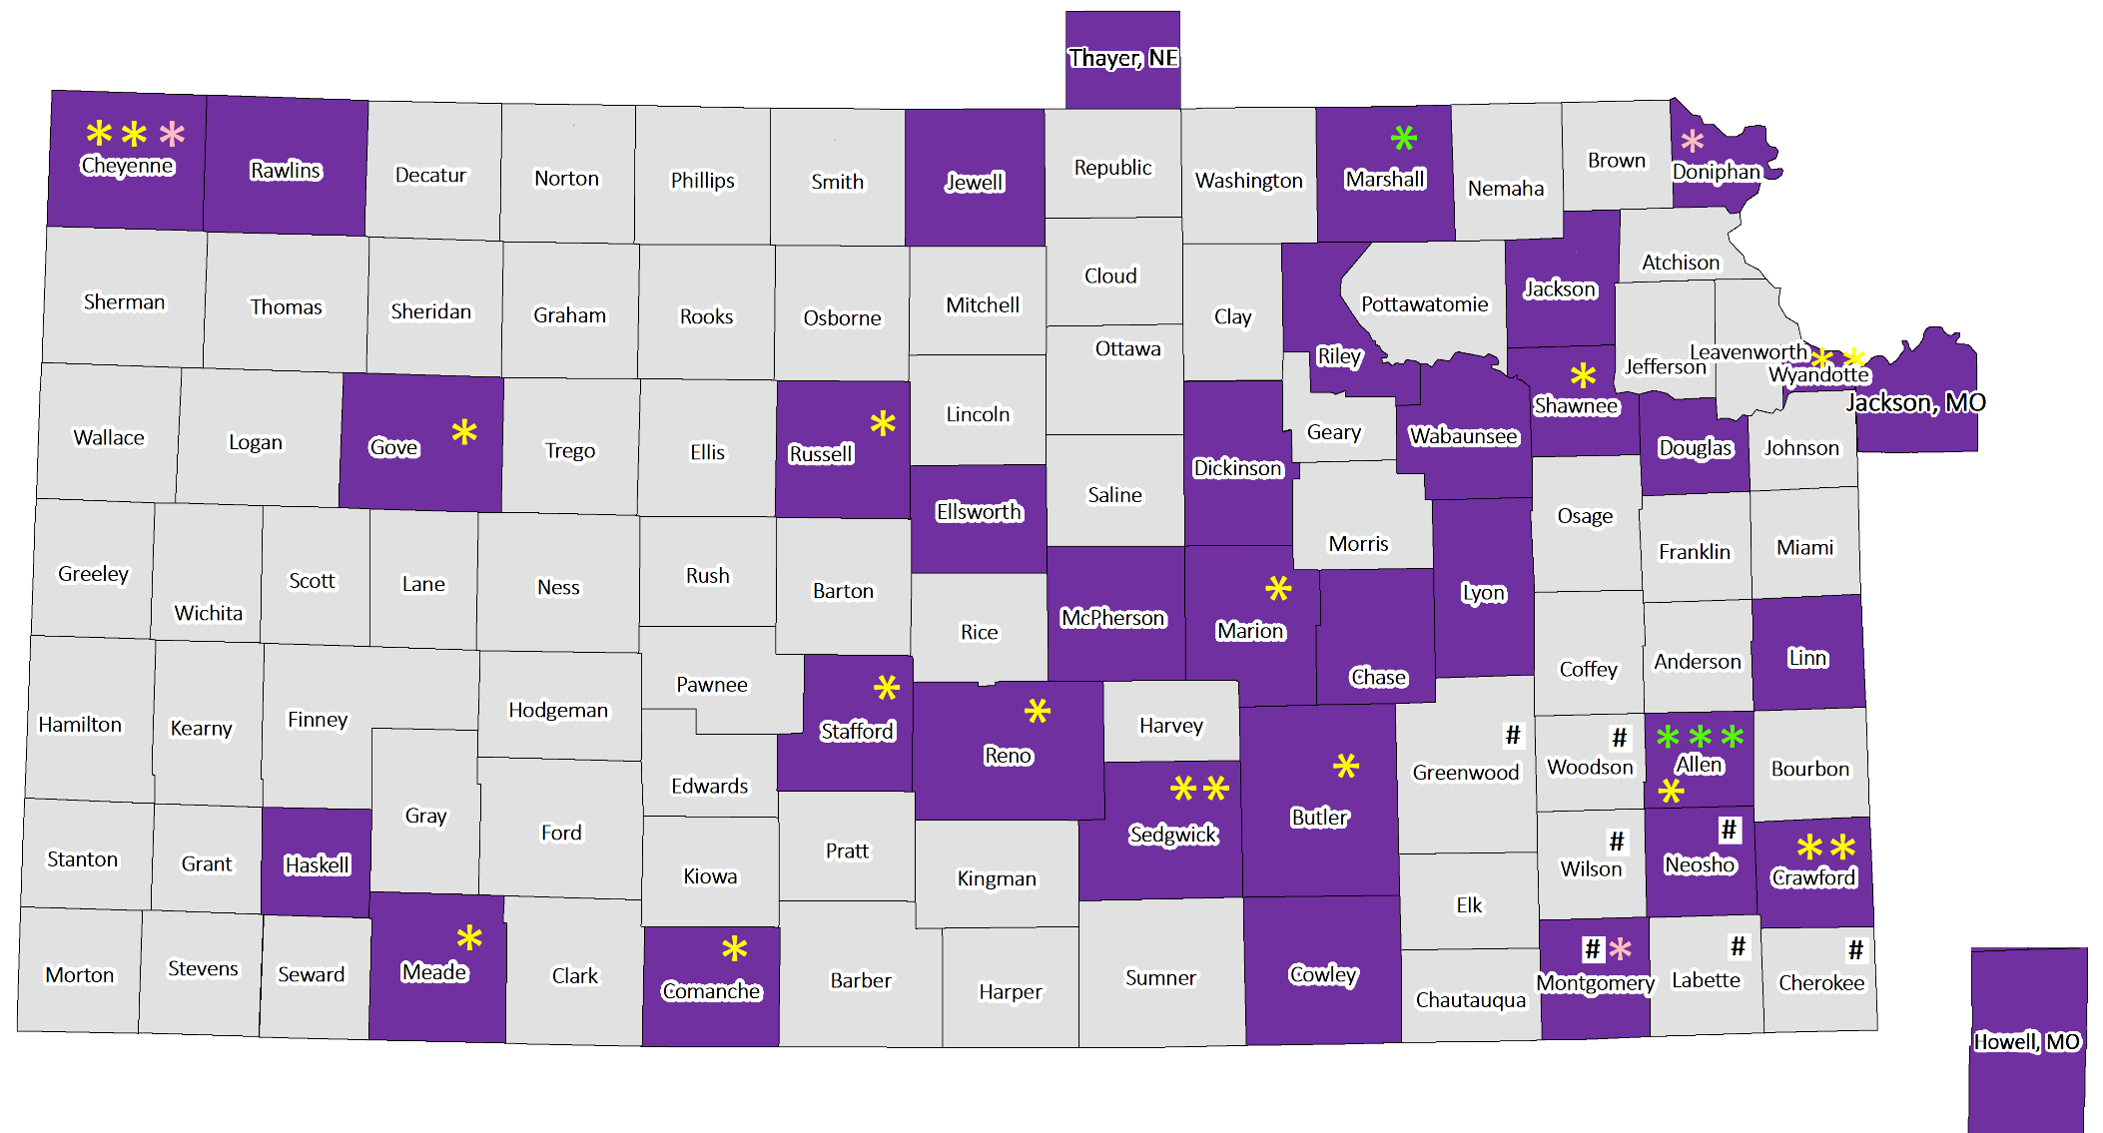
Geographic Reach of
KHFI Applicants as of Q1 2021
map inset;
not to scale
Applications received from purple-shaded counties (57 from 35 counties)
*=KHFI loan/grant (18); *=KHFI loan/grant + t.a. grant (4); *=t.a. grant only (3) ;
#
=7 store locations in S.E. KS that would be served by applicant based in Howell County, MO
Notes:
In Q1 2021:
7 intake forms were received from 2 new counties (Jackson Co., Kansas and Howell Co., Missouri) and 4 repeat counties (Sedgwick-2 projects, McPherson, Russell, and Douglas Co.)
3 new projects were approved for funding in Q1 2021 (2 were funded in 1 new county: Sedgwick, and 1 was funded in a repeat county: Cheyenne); 1 repeat project also received a 2nd round of funding (Tecklenberg in Reno County); NOTE: repeat project sites are only counted once but financing amounts are added to totals
Cumulative Counties Reached:
57 intake forms have been received from 35 counties
25 projects have been approved for KHFI funding in 17 counties
4 of these 25 projects also received t.a. grants (green stars); 3 of these projects were t.a. only grants (pink stars)
Note: As of Q1 ’21, funds have been disbursed to all 25 approved projects

Slide 7
KHFI Process
Rial Carver

Slide 8
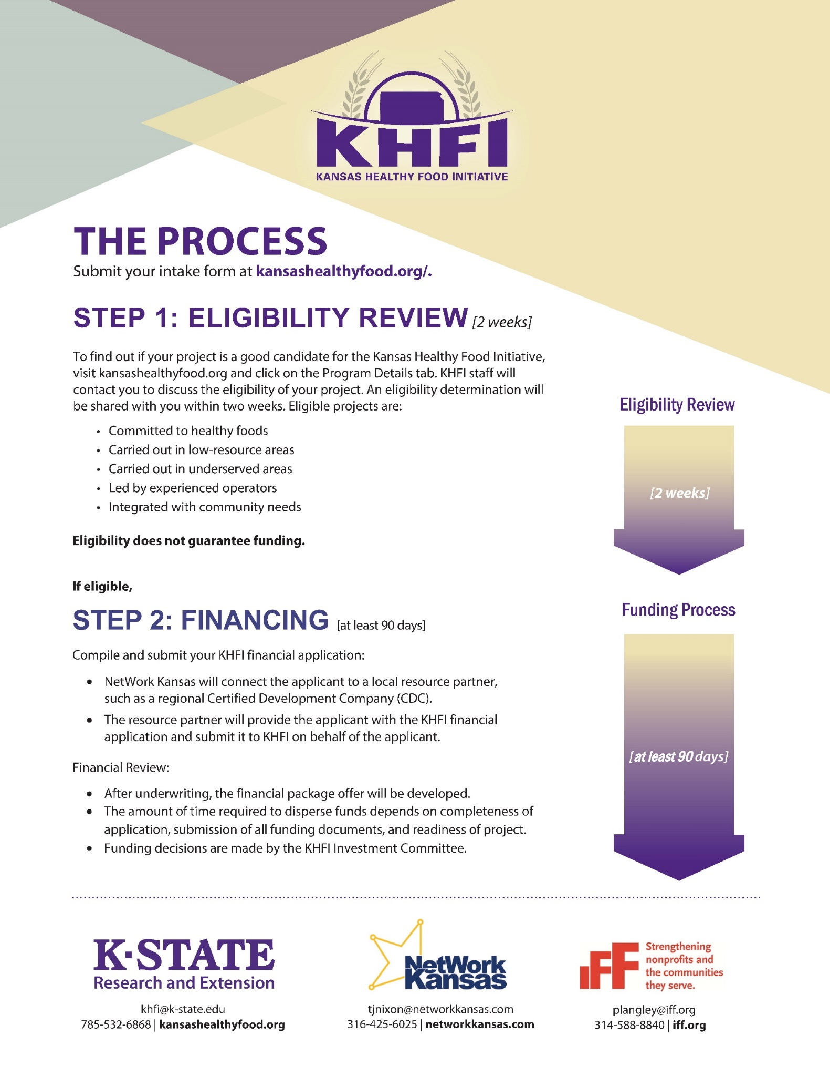
Eligibility Review:
Does the project meet programmatic goals?
Financial Review:
If eligible, applicant will be connected to resource partner to help complete the financial application.

Slide 9
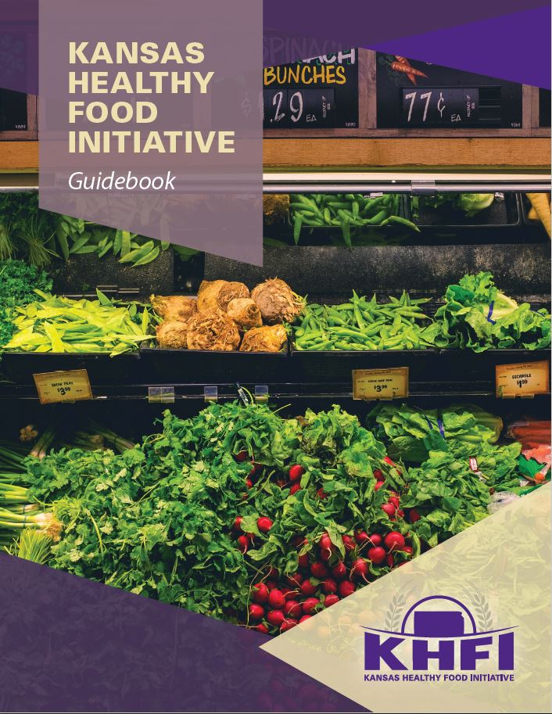
Projects are evaluated for program fit based on the following:
  Committed to healthy foods
  Carried out in low-resource areas
  Carried out in underserved areas
  Led by experienced operators
  Integrated with community needs
www.kansashealthyfood.org

Slide 10

Projects are evaluated for program fit based on the following:
  Committed to healthy foods
  Carried out in low-resource areas
  Carried out in underserved areas
  Led by experienced operators
  Integrated with community needs
www.kansashealthyfood.org
Notes:
Whole fruits and vegetables, whole grains, fat free or low-fat dairy, lean meat and protein (fresh, refrigerated, frozen or canned)

Slide 11
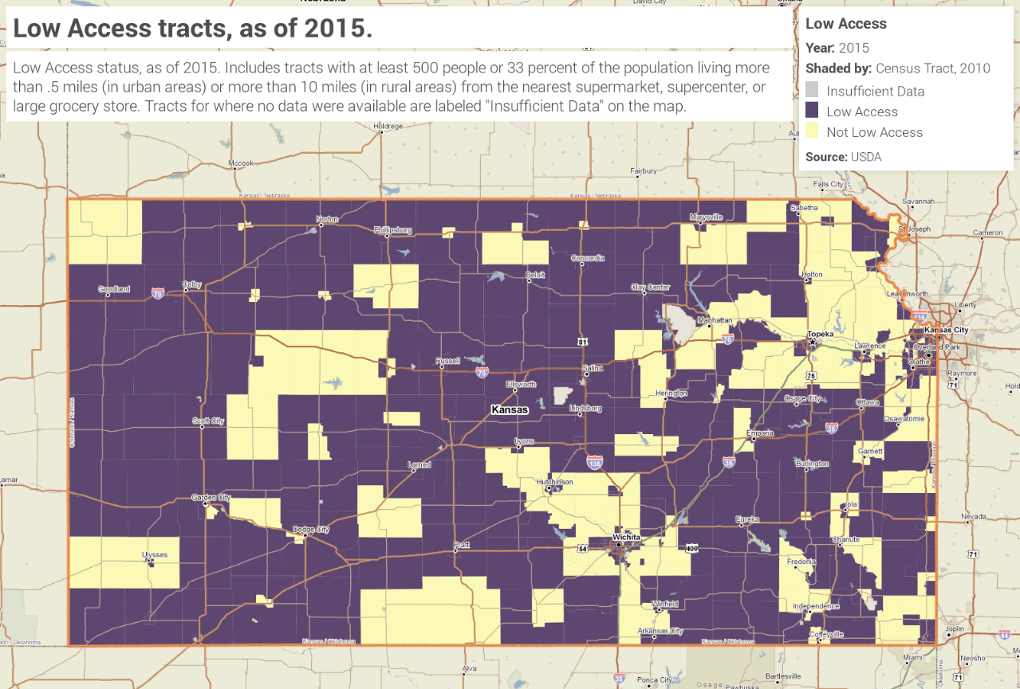
Low-resource indicators:
USDA Low Income and Low Access
Free and/or Reduced-Price lunch rates
Eligible for New Market Tax Credits
Eligible for Community Reinvestment Act
Projects are evaluated for program fit based on the following:
  Committed to healthy foods
  Carried out in low-resource areas
  Carried out in underserved areas
  Led by experienced operators
  Integrated with community needs
www.kansashealthyfood.org

Slide 12
Projects are evaluated for program fit based on the following:
  Committed to healthy foods
  Carried out in low-resource areas
  Carried out in underserved areas
  Led by experienced operators
  Integrated with community needs
www.kansashealthyfood.org
Community Fit Questions
How does this fit into broader community goals?
Where would people shop otherwise?
Who else should we speak to about this project?

Slide 13
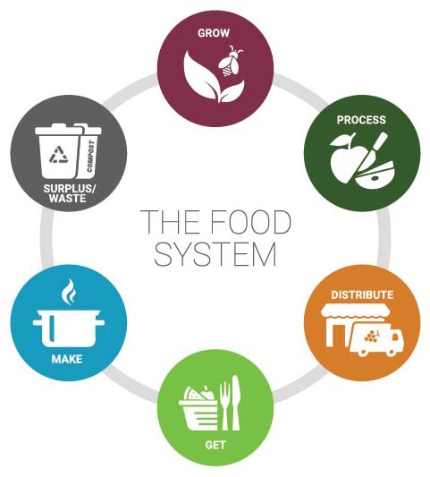
Funding Options
  Loan-grant mix: 85% loan/ 15% grant
  Grant-only: Up to $15,000
Fundings
  Building acquisition
  Equipment
  Energy Efficiency Improvements
  Inventory
  Point of Sale Upgrades
  Renovations

Slide 14
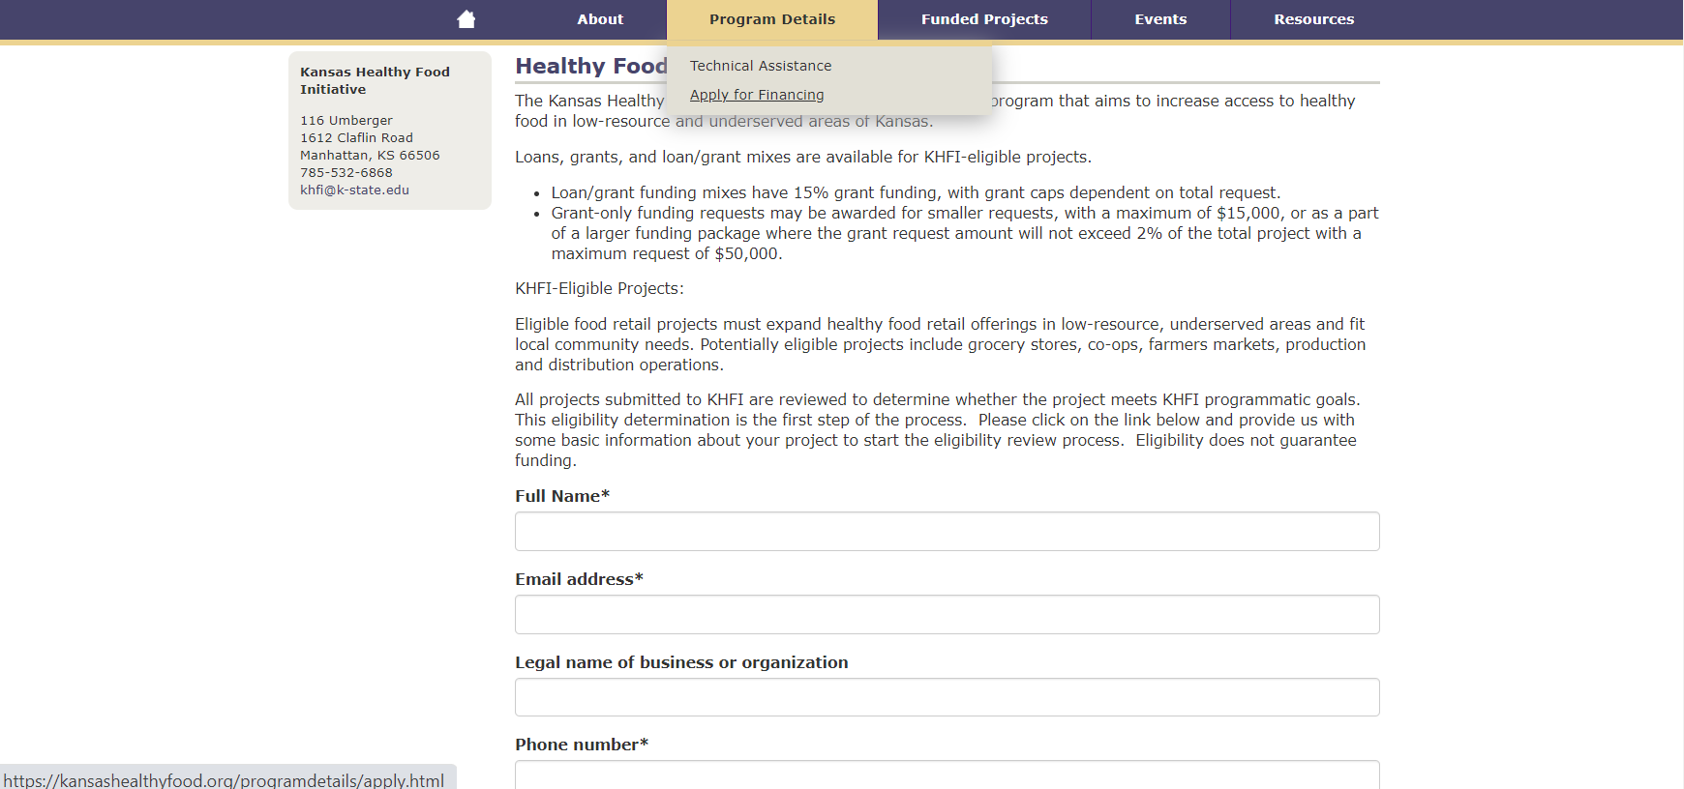

Slide 15
KHFI Examples and Success Stories
Erica Blair

Slide 16
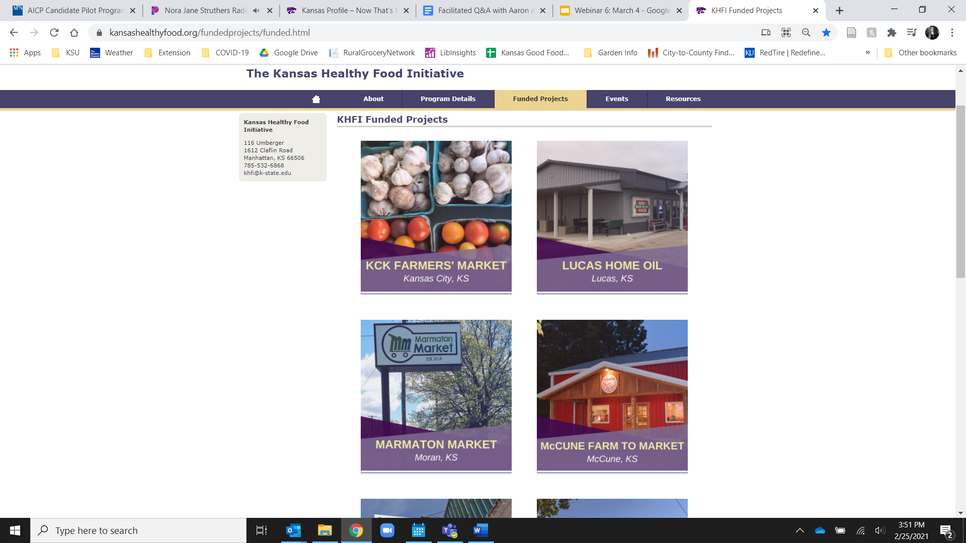
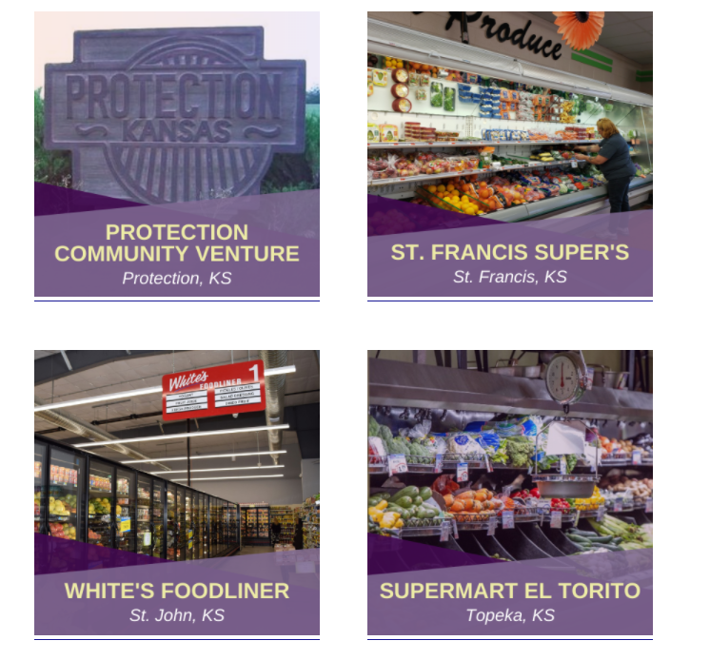

Slide 17
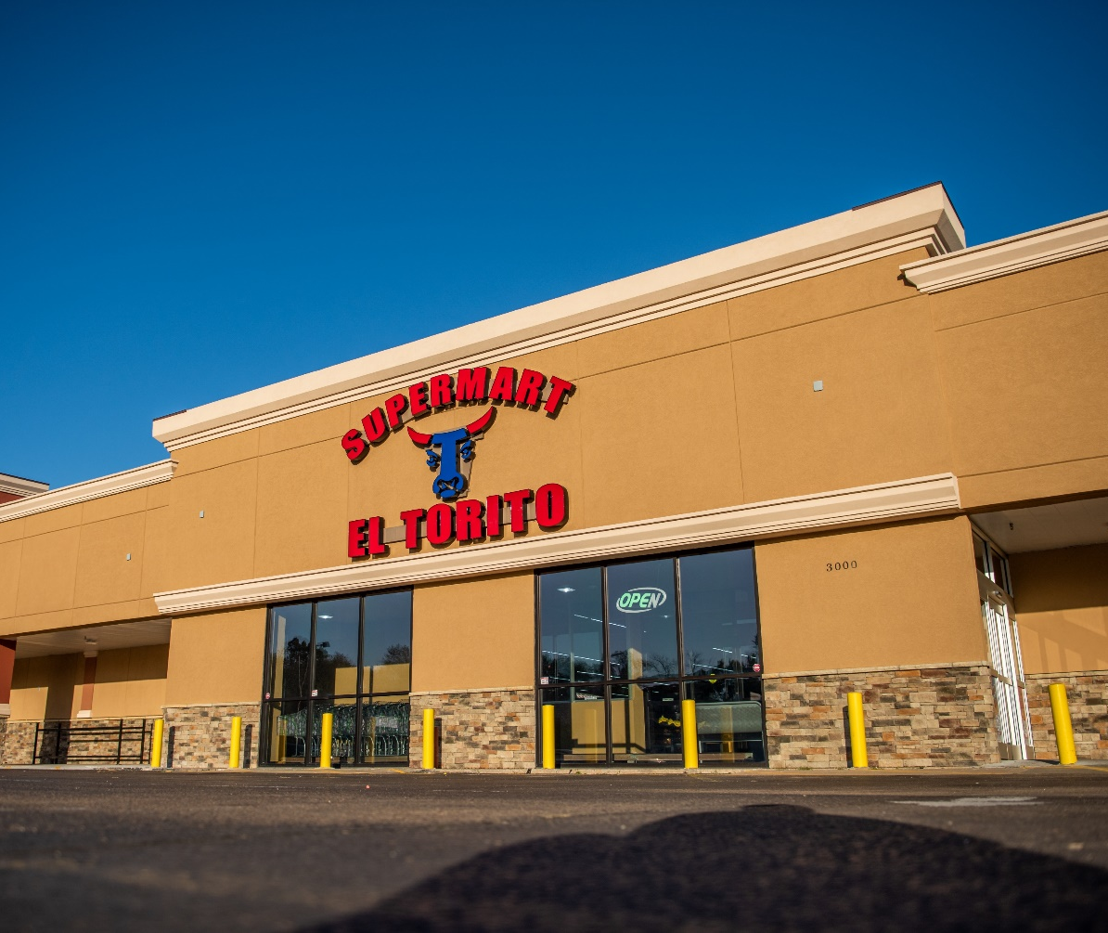
Supermart El Torito
Location: Topeka, KS
Background: Residents in Topeka and surrounding cities were driving to Kansas City or Wichita to find authentic Hispanic foods for their family. Octavio Sosa owned a Hispanic grocery store in Kansas City, and his customers frequently asked him to open another store in Topeka.
KHFI funding: Loan/grant mix
Funding use: Cover the cost of initial store inventory to open the store
Notes:
Loan Amount: $455,000
Grant Amount: $52,000

Slide 18
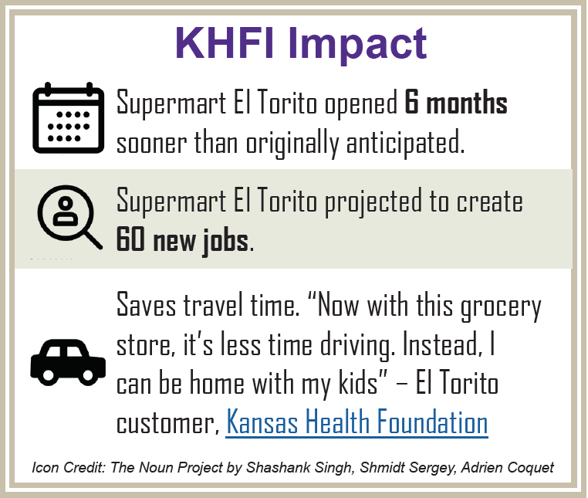
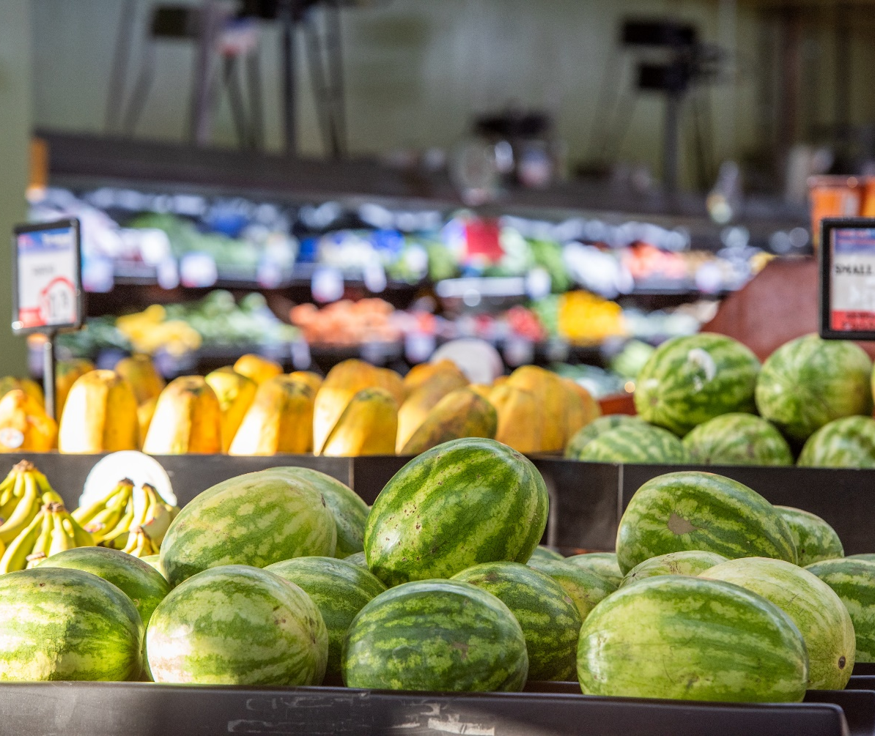
Supermart El Torito

Slide 19
Bluestem Mercantile
Location: Leon, KS
Background: Over the past 10 years, Bluestem High School has offered an entrepreneurship class for students. The school district decided to open a grocery store to provide both educational opportunities and a critical service for the community.
KHFI funding: Loan/grant mix
Funding use: Purchase equipment, including coolers and shelving; purchase initial inventory; repair the roof on the building
Notes:
Loan Amount: $15,300
Grant Amount: $16,000

Slide 20
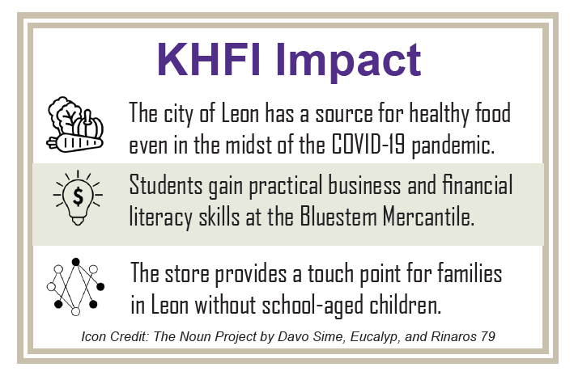
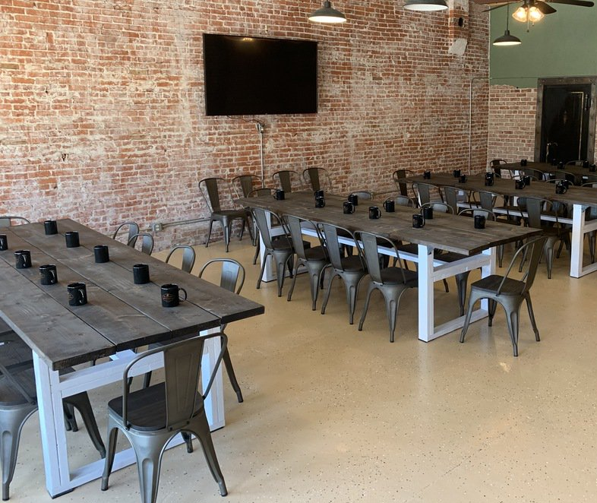
Bluestem Mercantile
Notes:
In 2016, the local Dillon’s closed its doors. Stafford County Economic Development took the lead in bringing White’s Foodliner to town, which opened in 2018.

Slide 21
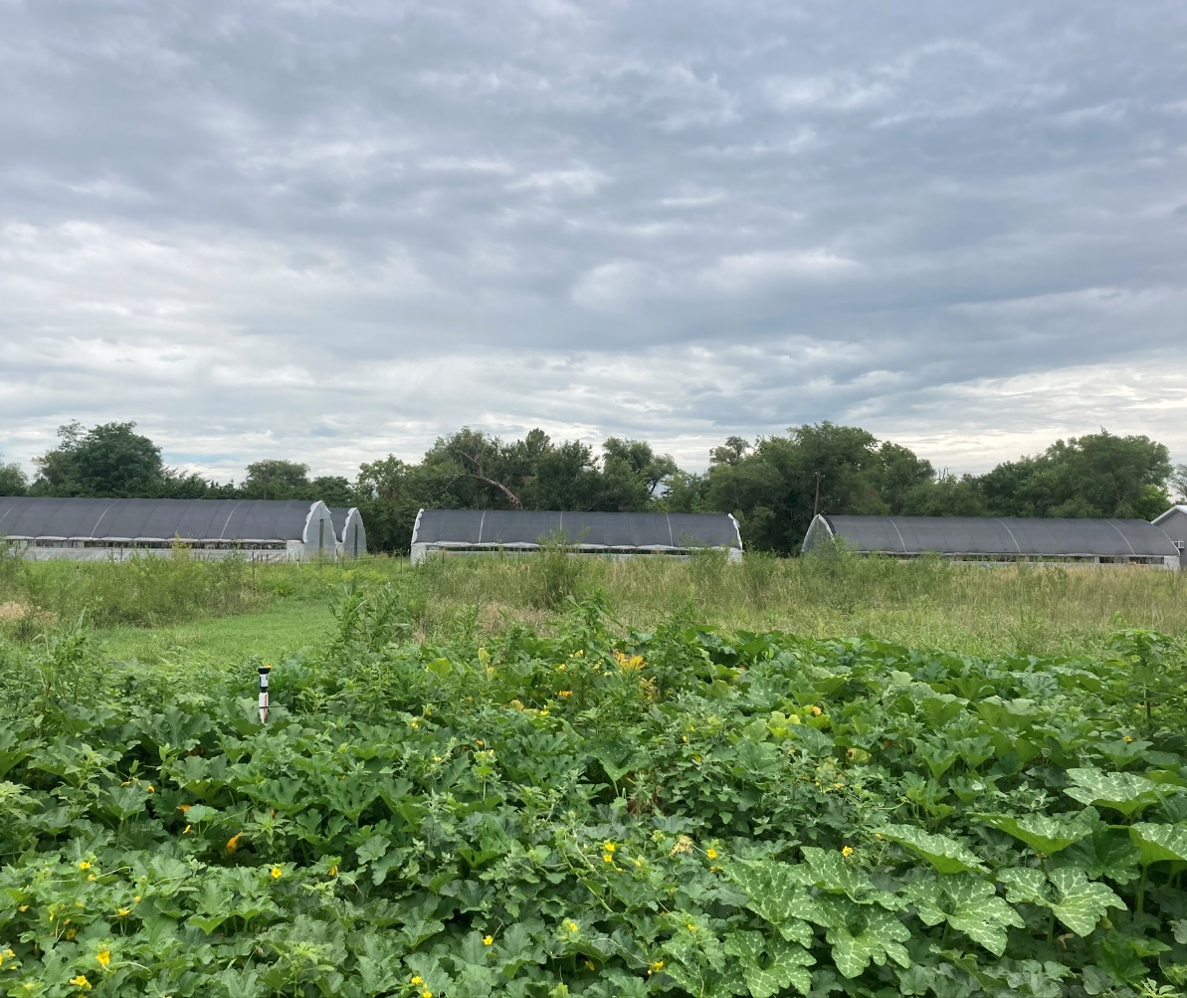
Teck Farms
Location: Hutchinson, KS
Background: Many parts of Hutchinson and the neighboring city of South Hutchinson are underserved by healthy food retail. Chris and Shawna Tecklenburg decided to address this challenge by starting an urban farm that would supply fresh produce to the local community.
KHFI funding: Grant
Funding use: Construction of a post-harvest handling and distribution facility to move produce to local grocery outlets
Notes:
$15,000 grant

Slide 22
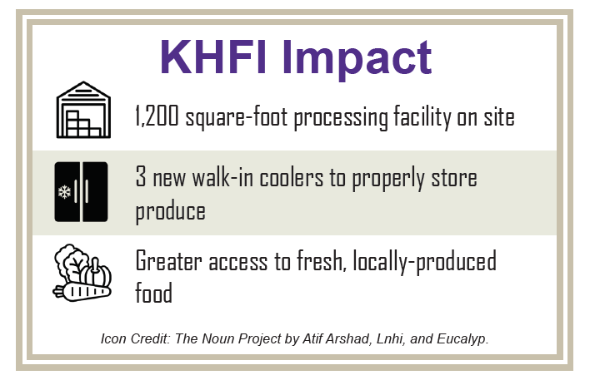
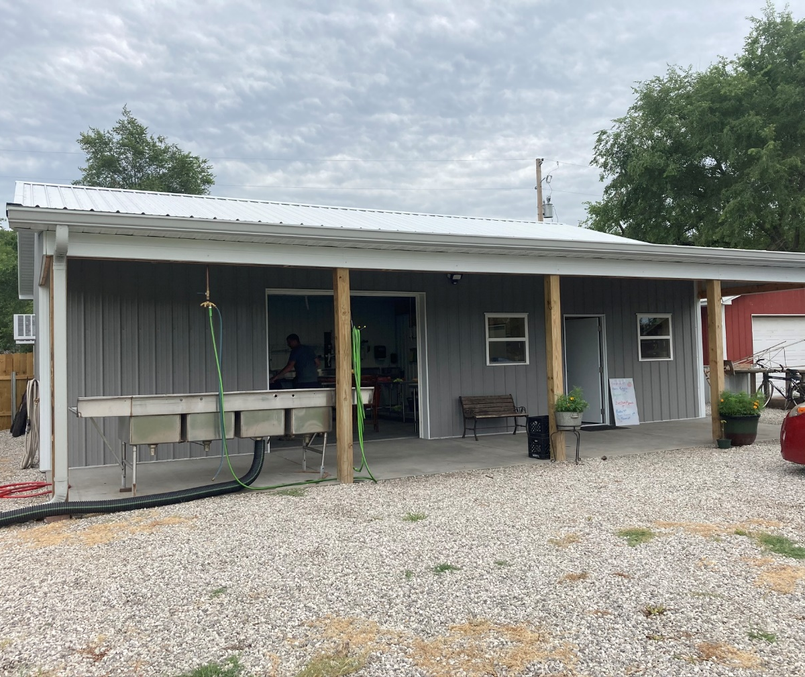
Teck Farms
Notes:
In 2016, the local Dillon’s closed its doors. Stafford County Economic Development took the lead in bringing White’s Foodliner to town, which opened in 2018.

Slide 23
Email: khfi@ksu.edu
Website: www.kansashealthyfood.org

