Slide 1
Rural Grocery Initiative
June 21, 2021

Slide 2
Food Access & Food Insecurity
Understanding food access in Kansas
Erica Blair
Why does it matter?
Dr. David Procter
Solutions to address lack of food access
Rial Carver

Slide 3
Understanding food access in Kansas
Erica Blair, Rural Grocery Initiative

Slide 4
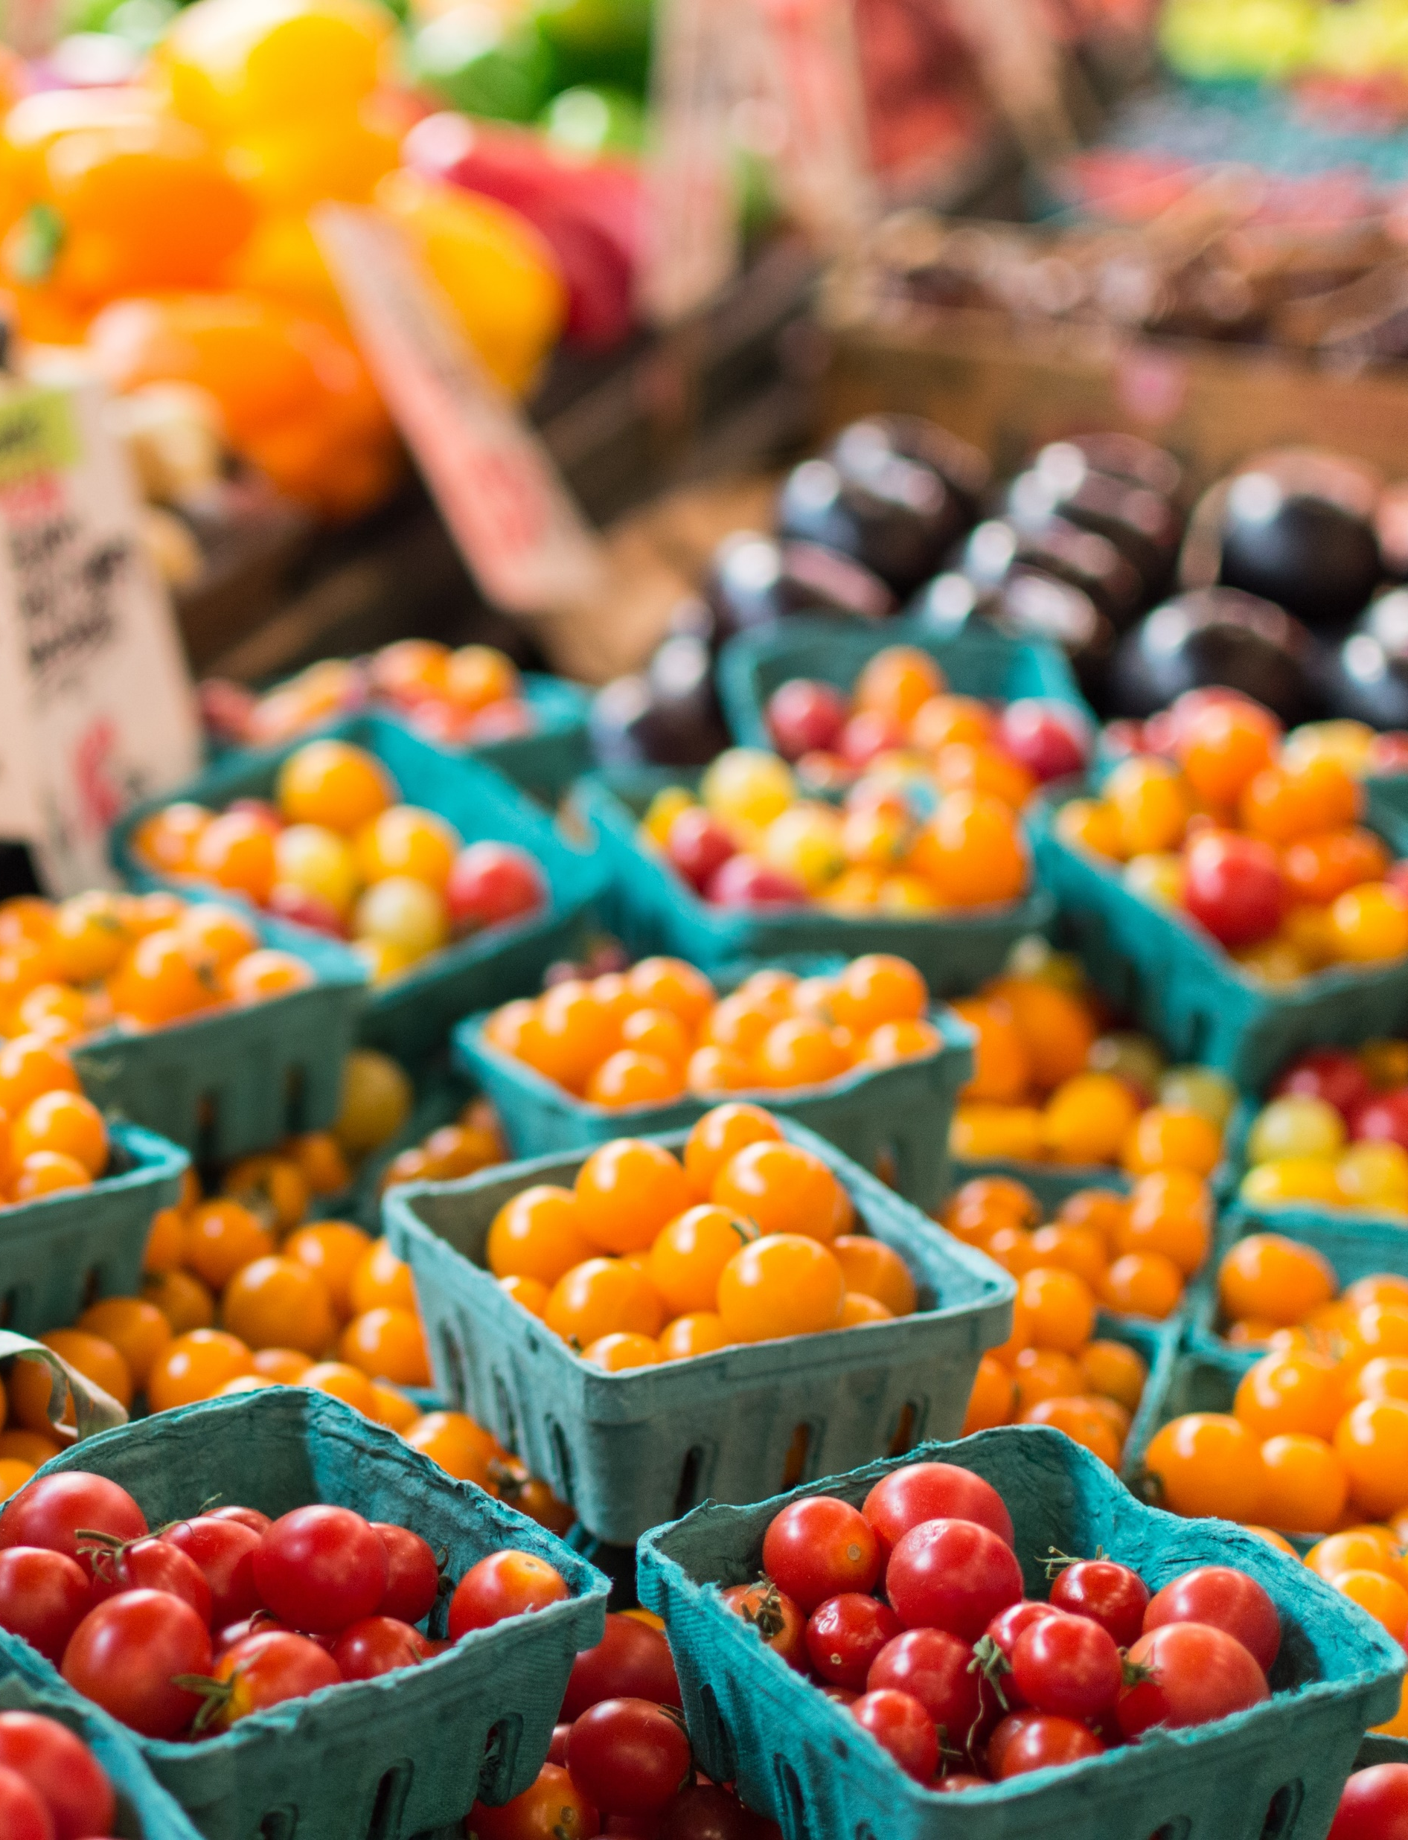
Food is accessible when it is affordable and community members can readily grow or raise it, find it, obtain it, transport it, prepare it, and eat it.
“
https://healthyfoodpolicyproject.org/about/key-definitions

Slide 5
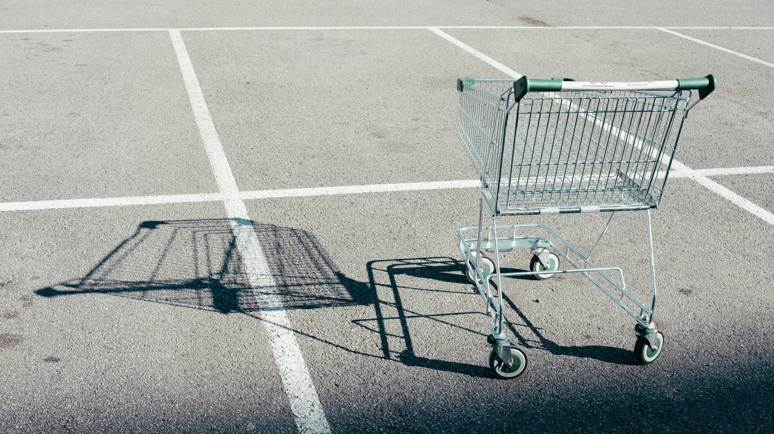

Lack of food access
Food insecurity
Food deserts
Food swamps
Food apartheid

Slide 6
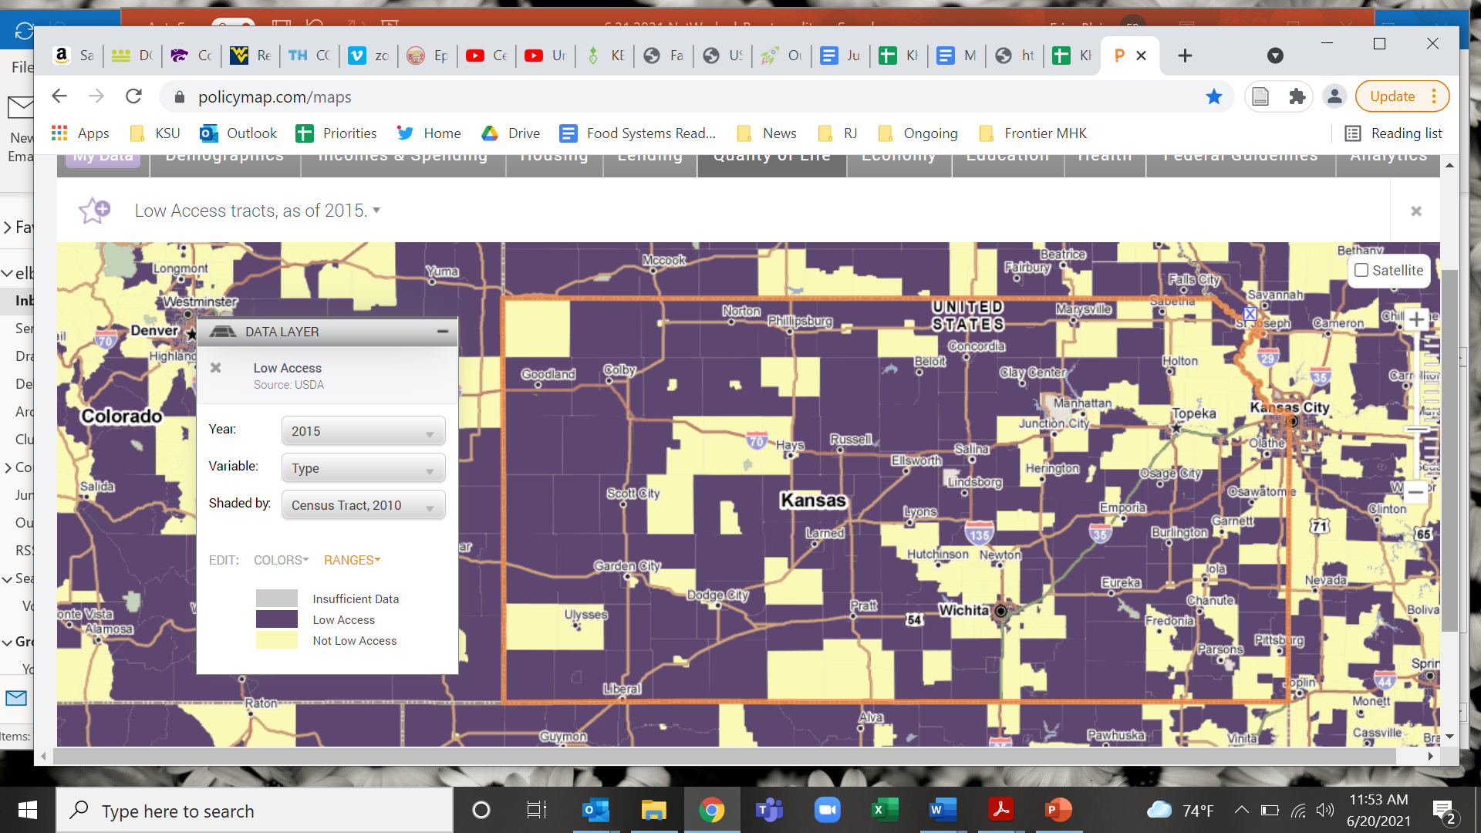
Food access in Kansas
Source: PolicyMap, Low Access census tracts (USDA, 2015)

Slide 7
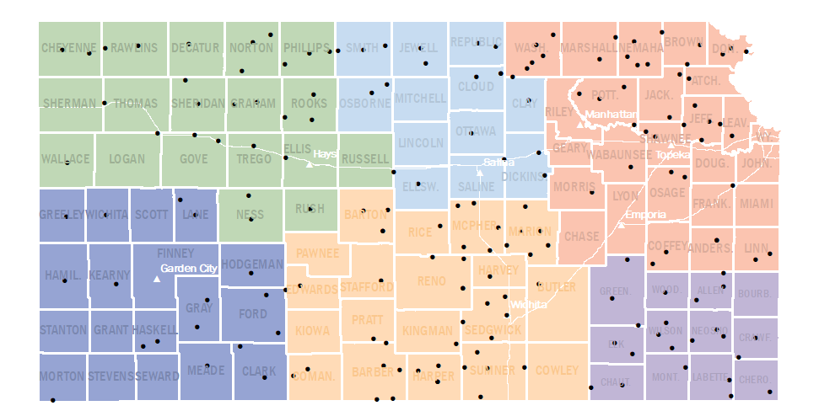
Rural grocery stores struggle to stay in business
Since 2008, 105 grocery stores in rural Kansas have closed their doors, in half of those communities a new store has not opened.
Kansas Rural Grocery Stores, 2019

Slide 8
Why does it matter?
Dr. David Procter, Rural Grocery Initiative

Slide 9
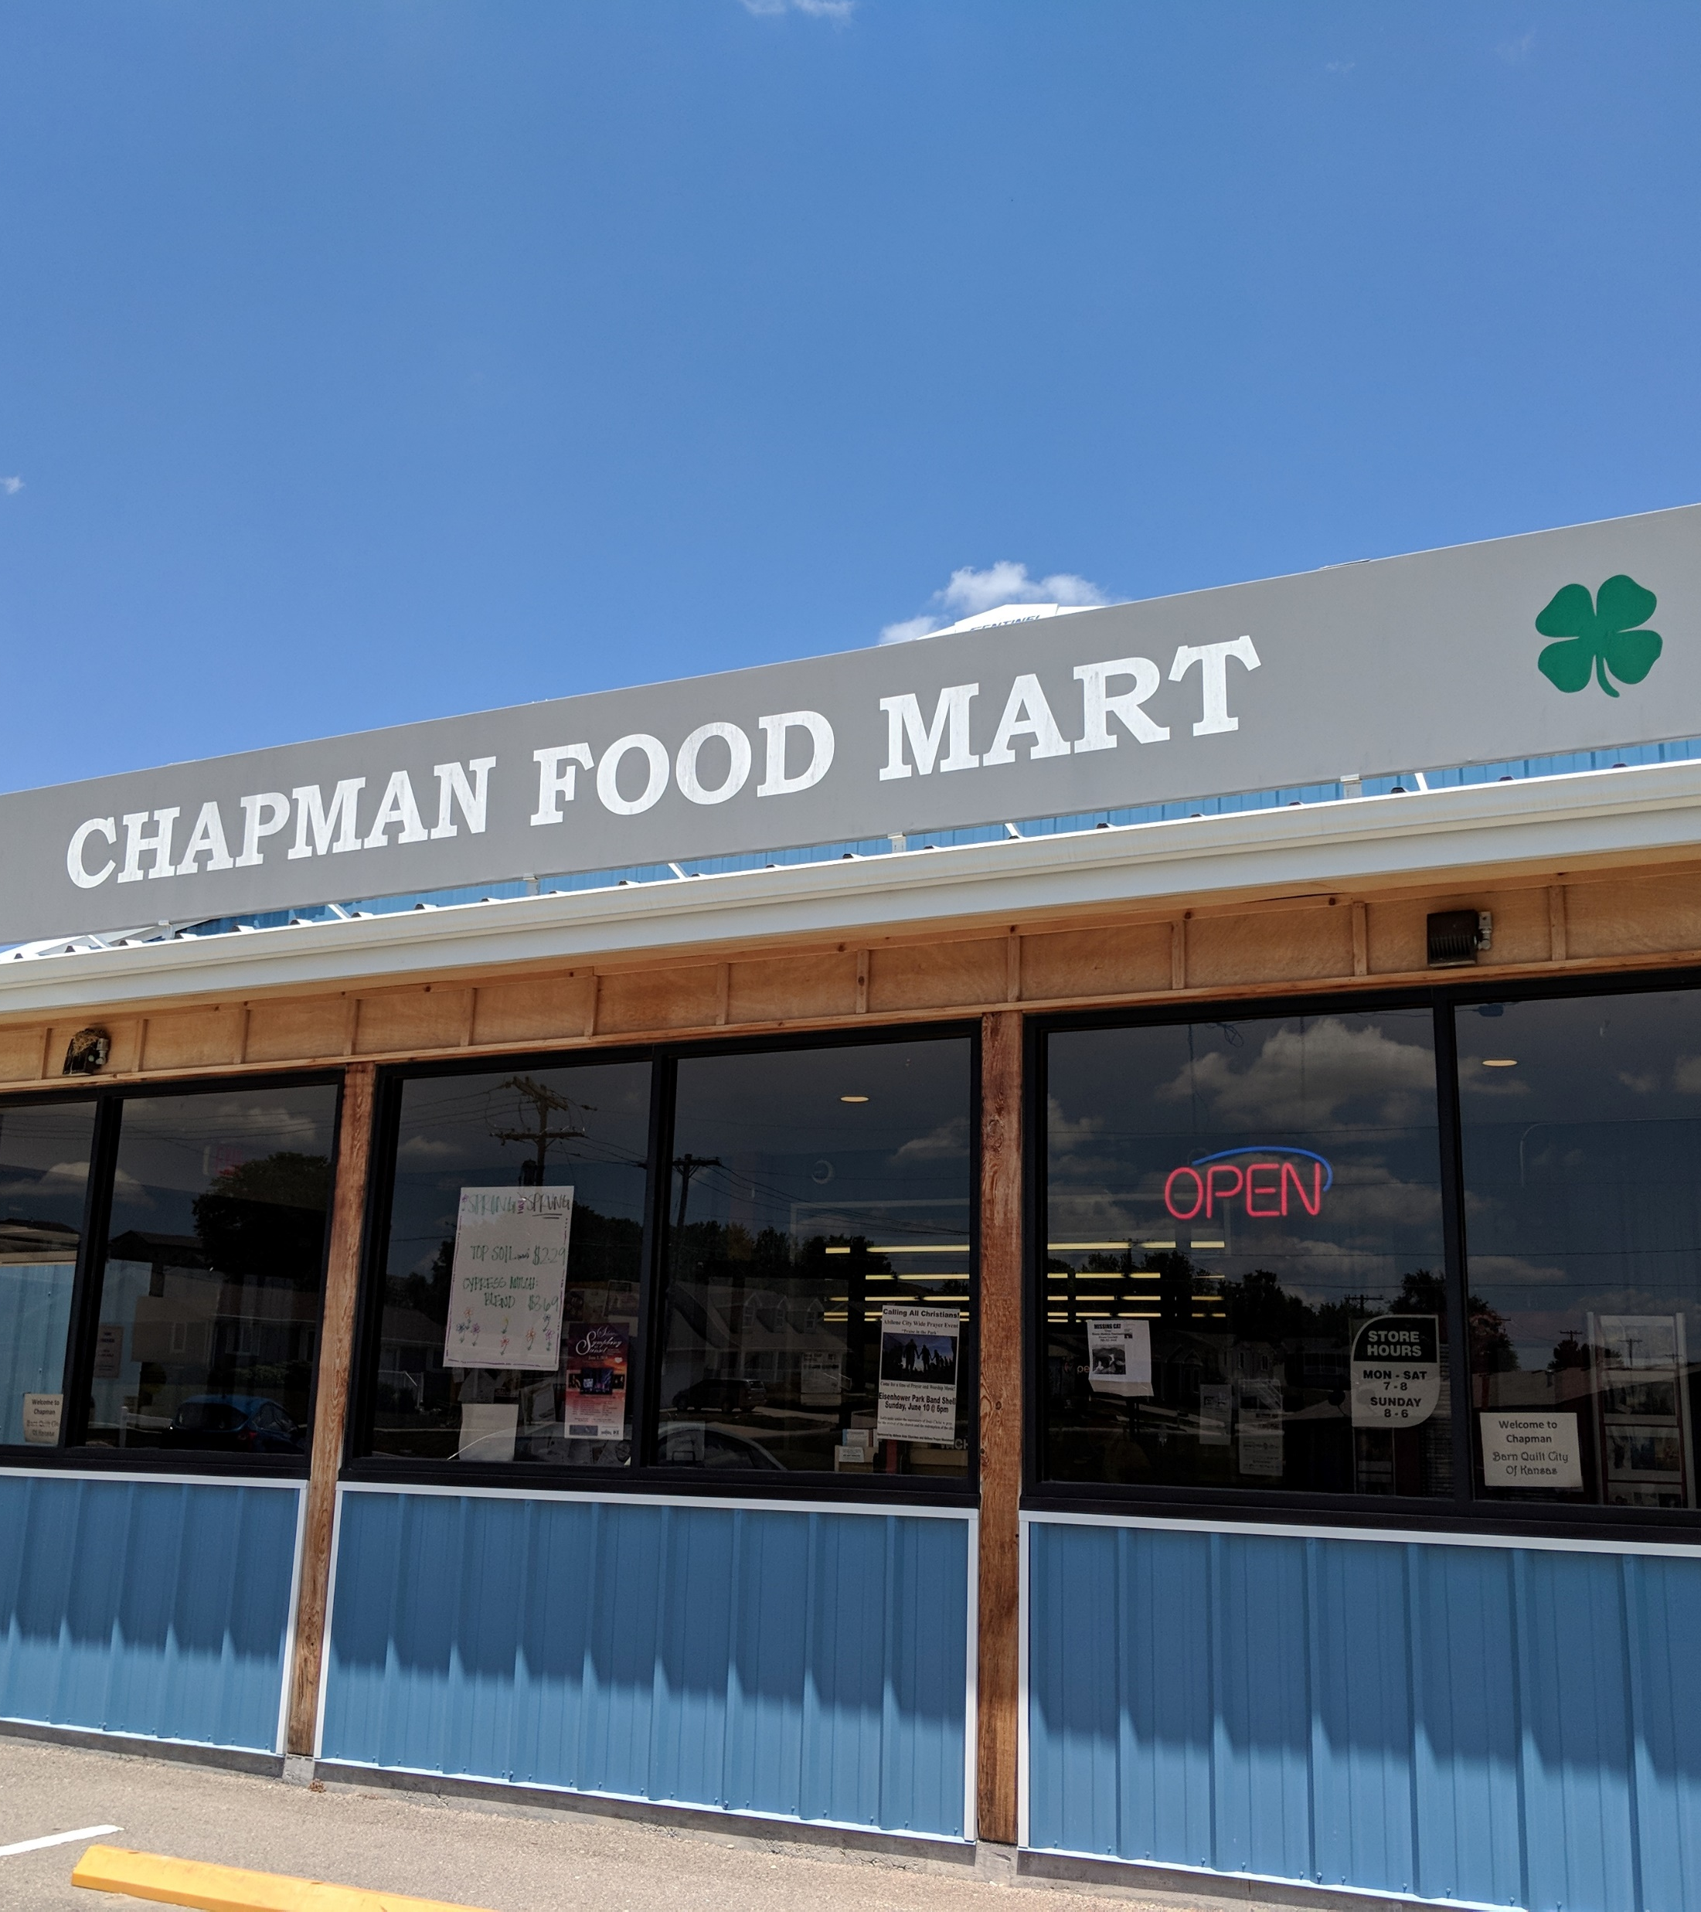
Healthy food retail provides:
Economic development
Healthy food access
Community gathering space

Slide 10
Economic Development
Rural grocery stores in KS, on average, contribute $644,000 to the local economy (Miller, 2015).
Independent grocery stores generate $135 million in
state and local tax dollars across Kansas (National
Grocers Association, 2021).
Kansas rural grocery stores provide, on average, 17 local jobs (CECD, 2008; Miller, 2015).
  6 full time; 11 part time
SNAP and WIC benefits provide economic stimulus
(Chrisinger, 2015; Reinhardt, 2018).
  SNAP puts food dollars directly and indirectly into local economies.
  Food Dollar Leakage: Local grocery stores are critical for capturing SNAP dollars
Locally-owned, small business have a larger economic multiplier (KSU Ag Econ study, 2020).
Grocery stores are resilient businesses in economic downturn times (Keen, 2011).

Slide 11
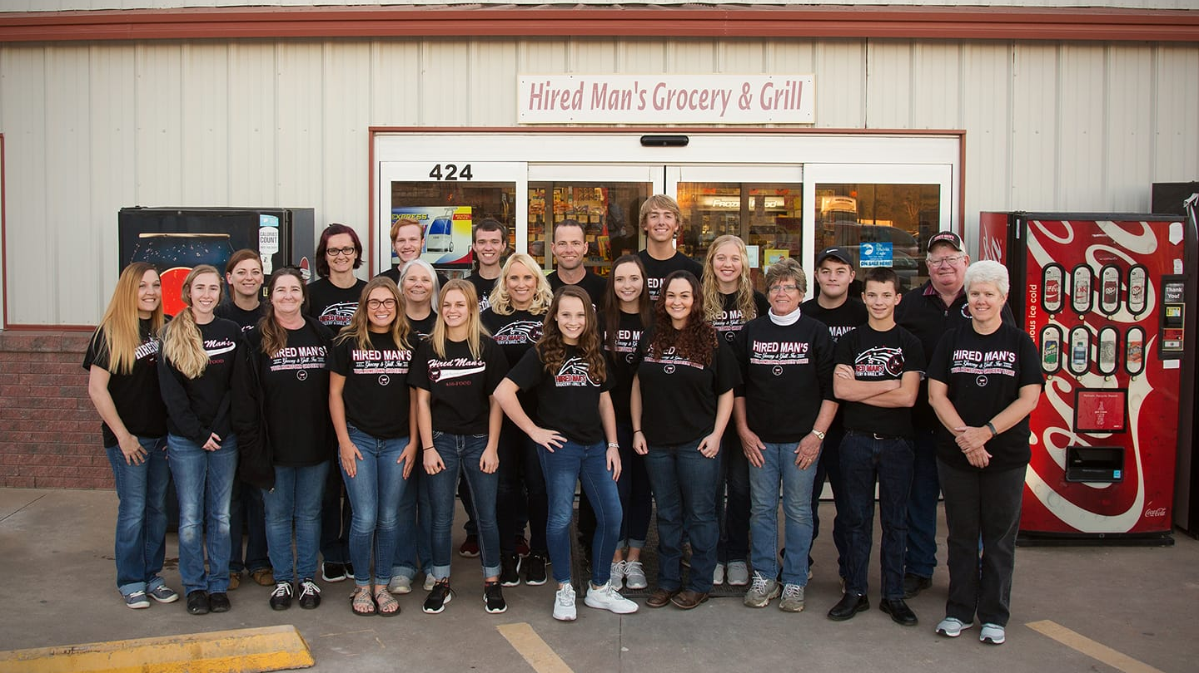

Slide 12
Healthy
Food
Access
Food insecurity is linked to chronic illnesses such as heart disease, type 2 diabetes, and obesity (Bird, 2020).
Rural areas suffer the highest obesity rates
in the nation (Center for Study of Rural
America, 2006).
Presence of grocery stores in non-metro
counties is inversely associated with incidence of obesity (Jilcott, 2011).
Grocery stores offer more healthy
foods at lower cost than rural convenience
stores (Liese, 2007).
Notes:
Bullet #1: Bird, E. (2020). “Food insecurity in the US increasingly linked to obesity.” Medical News Today. https://www.medicalnewstoday.com/articles/food-insecurity-in-the-us-increasingly-linked-to-obesity

Slide 13
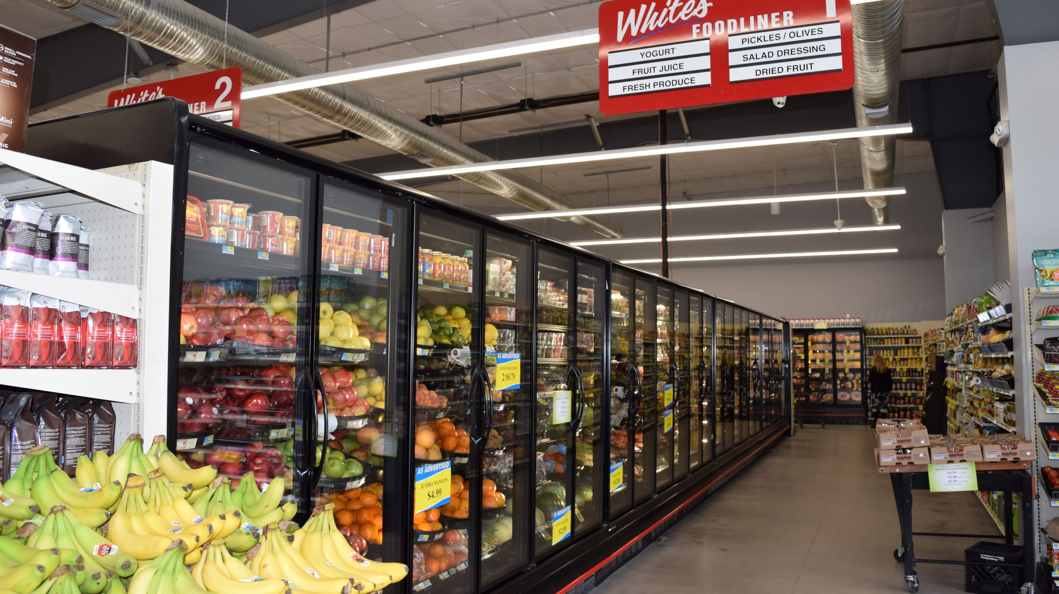

Slide 14
Community Hubs
Grocery stores function as anchors of
community life.
  Help form community identity
  Familiar places where community bonds
  are created and sustained
  Build social capital
Grocery stores provide public gathering places
for community members to connect.
  Cafes, delis
  Clubs, libraries, art galleries
  Neutral spaces for face-to-face small talk

Slide 15
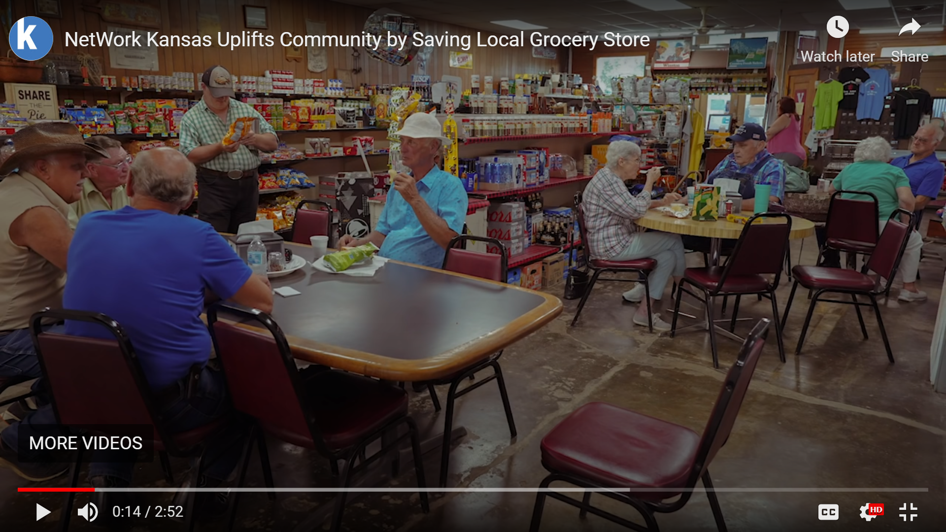
https://www.kauffman.org/currents/because-of-three-coolers-mildred-dances-on-saturday-nights/

Slide 16
Solutions to address lack of food access
Rial Carver, Rural Grocery Initiative

Slide 17
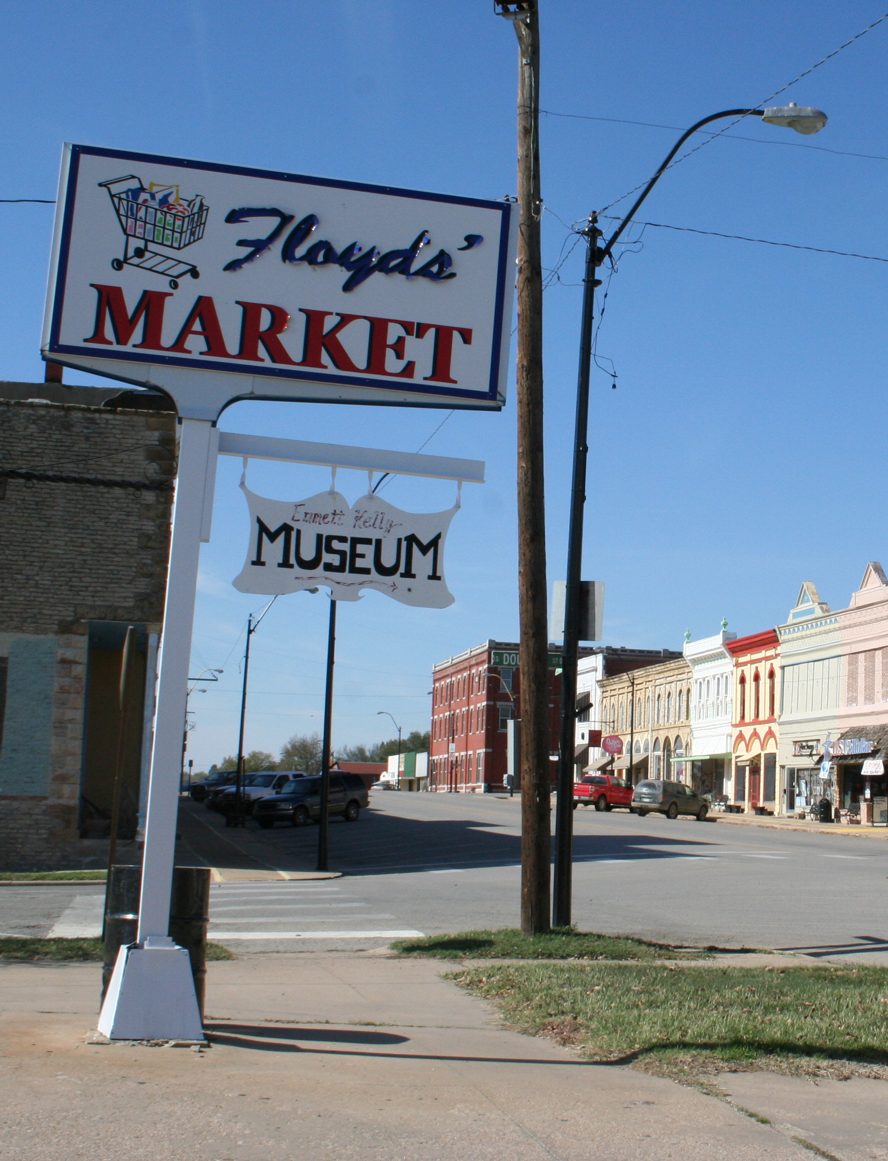
Rural Grocery Initiative
The mission of the Rural Grocery Initiative is to provide resources to help sustain and enhance independently-owned rural grocery stores. RGI assists communities and citizens to strengthen rural grocery operations and improve access to healthy foods.

Slide 18
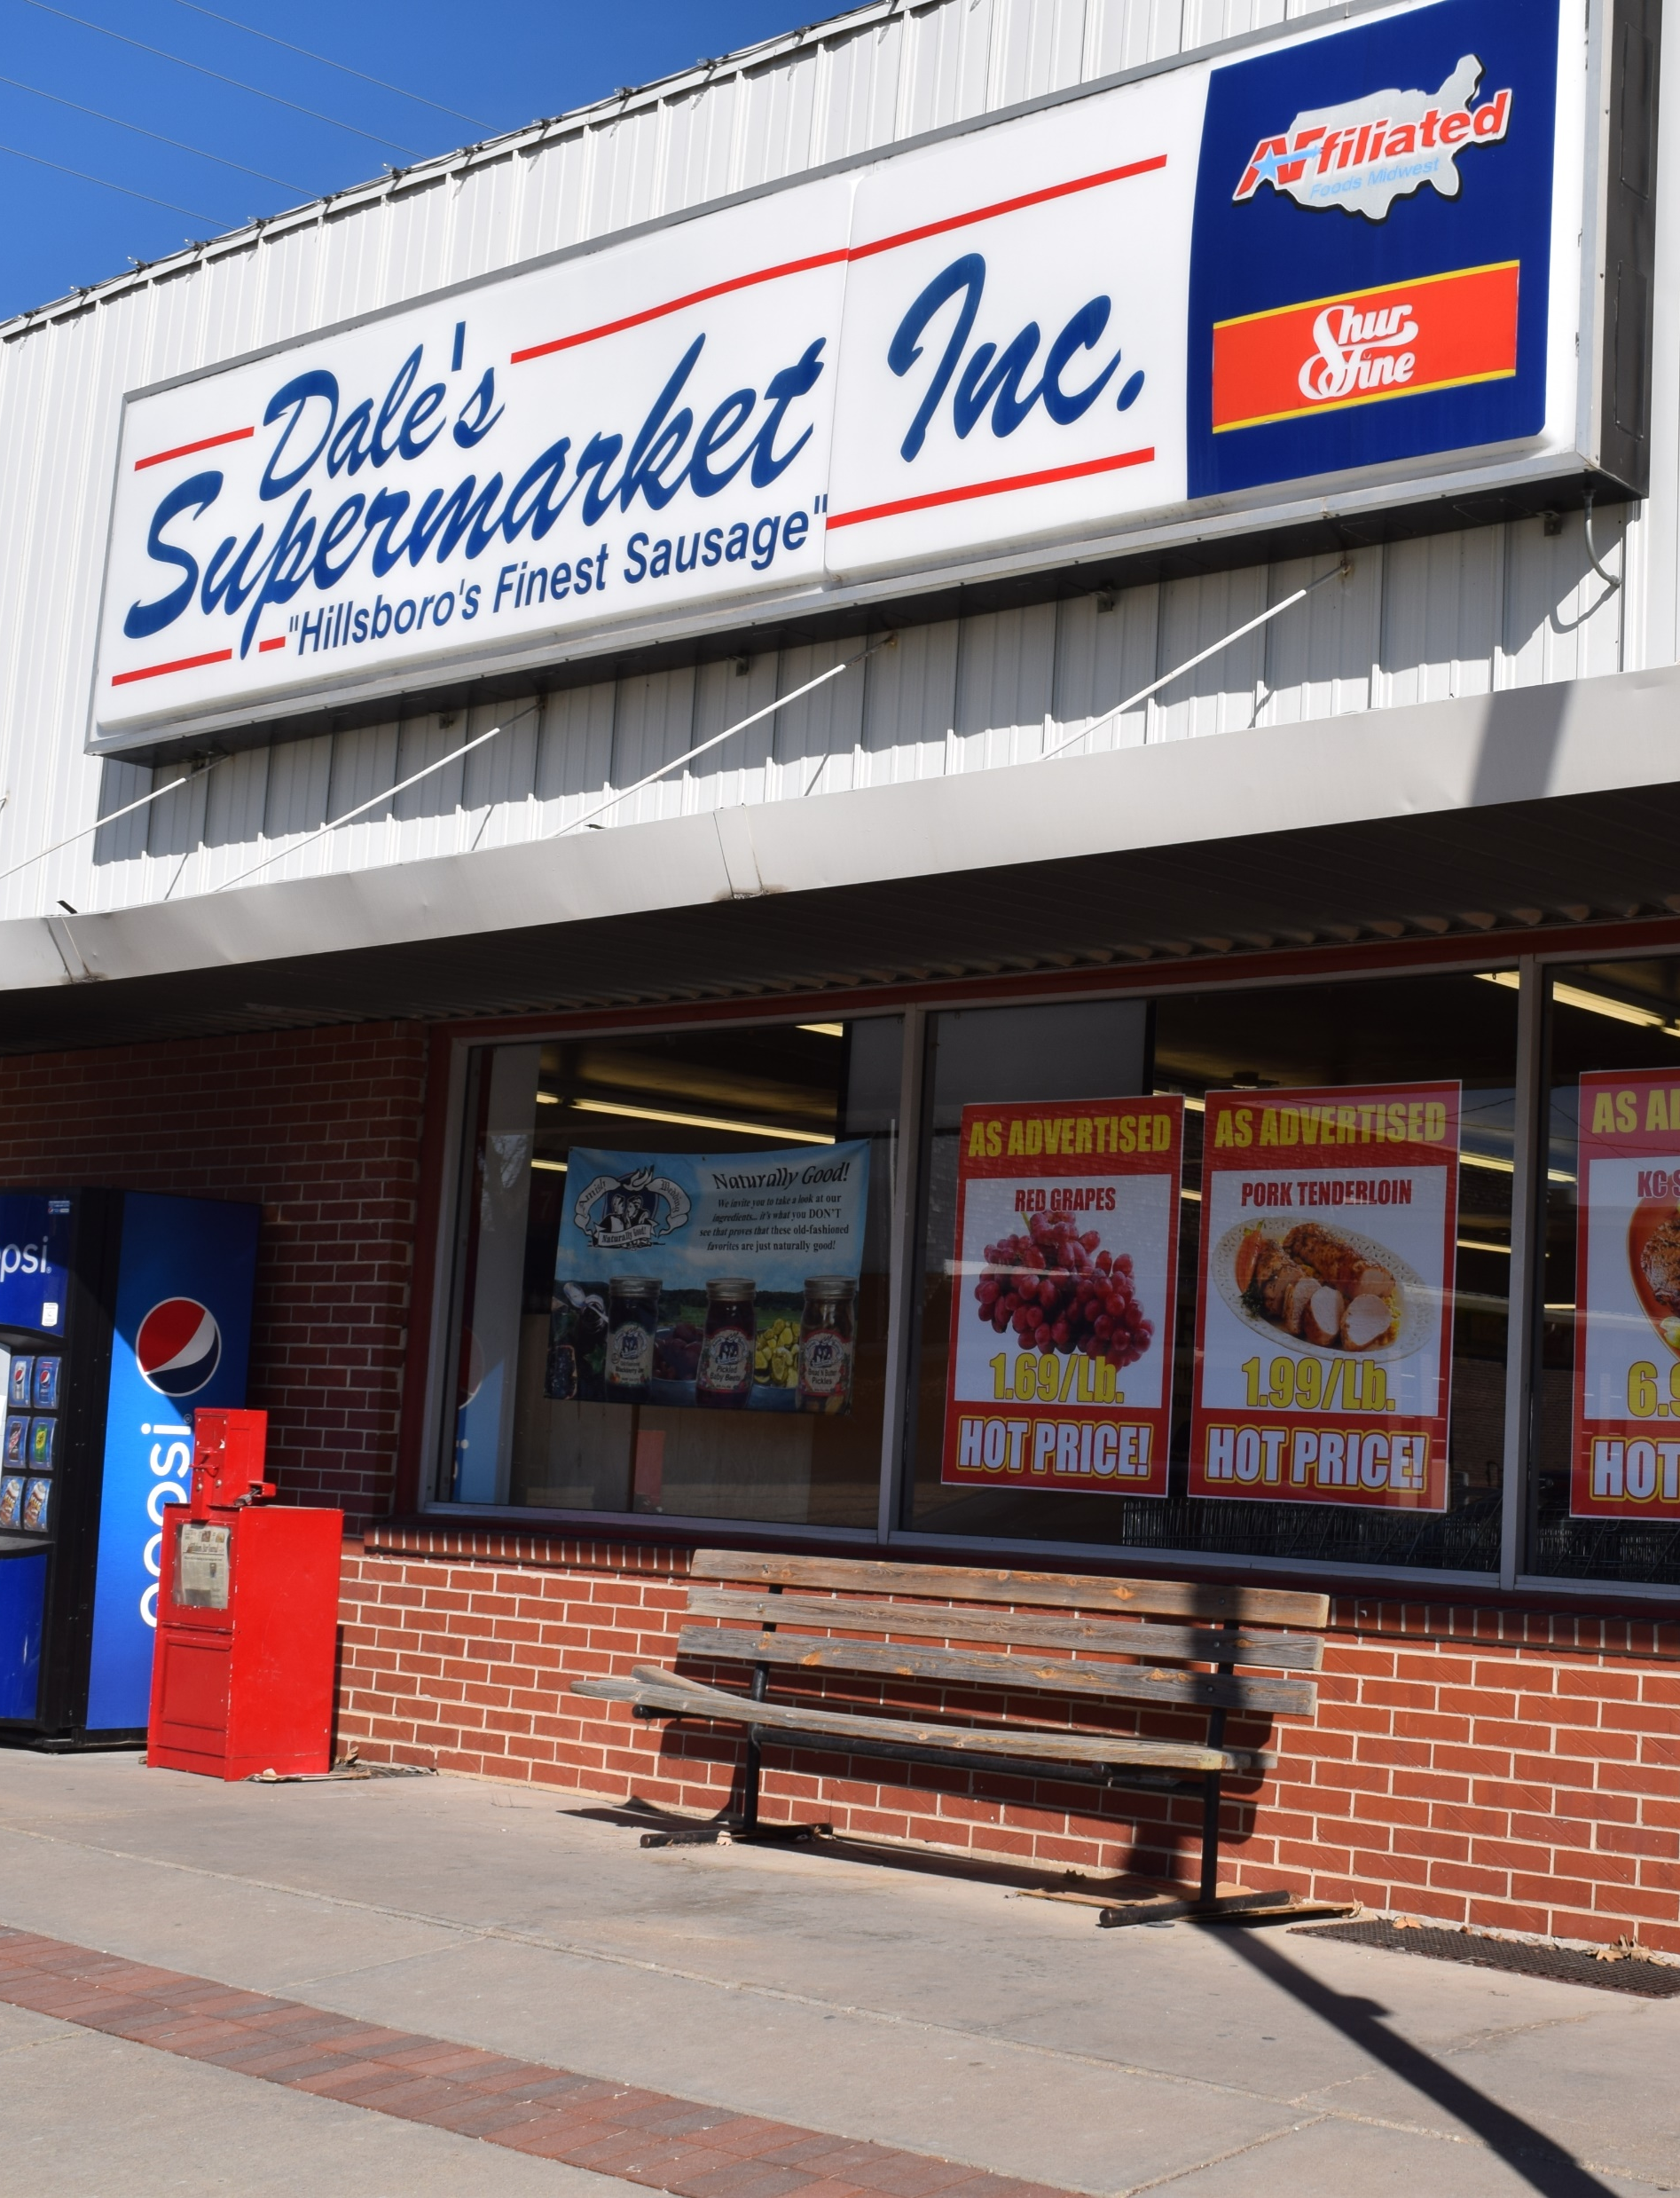
What does RGI do?
Provides technical assistance to grocers and communities related to rural grocery stores and/or healthy food access
Conducts research on relevant rural grocery and food access issues
Develops and maintains the Rural Grocery Toolkit
Hosts educational events and the biennial National Rural Grocery Summit
Serves as Food Access Organization for Kansas Healthy Food Initiative

Slide 19

Inquiry tracker – for review and development of new TA resources
Literature database – for published knowledge to send or summarize
Expertise directory – for referral among community practitioners
In-house resources – for sharing work and learnings from RGI (fact sheets, success stories)

Slide 20
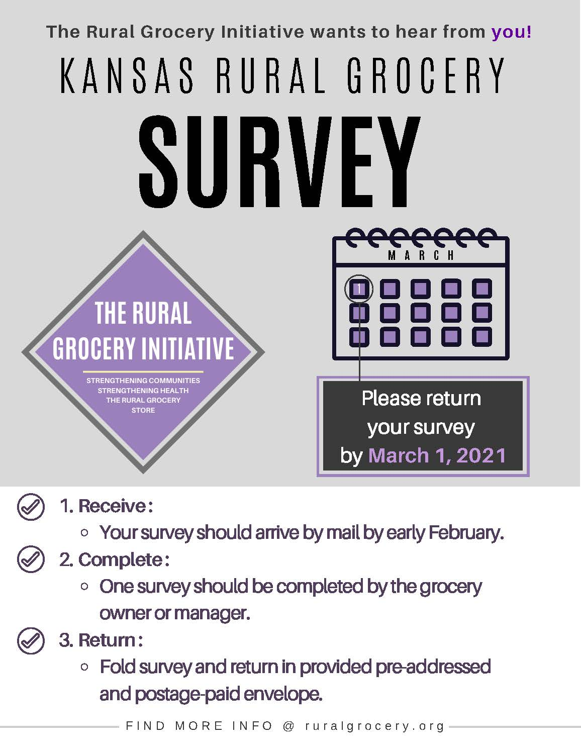
Research
Rural Grocery Survey, 2008 and 2021
Expanding healthy food access by strengthening social capital, 2017
Increasing Healthful Food Choice & Strengthening Rural Grocery Store through Nutritional Education and Labeling, 2014-2017

Slide 21
Rural
Grocery
Toolkit
For those establishing a rural grocery store:
For existing rural grocery store owners:
https://www.ruralgrocery.org/resources/RGToolkit.html

Slide 22

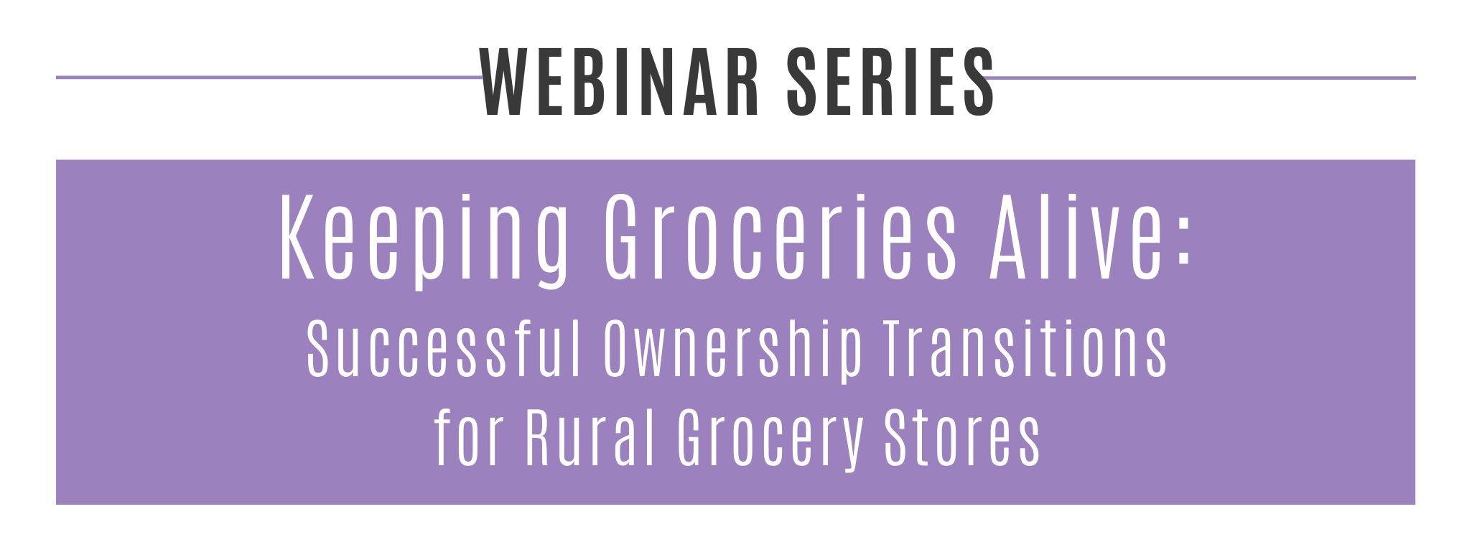
Grocery Business Transition Planning: An Overview
Understanding Grocery Ownership Models
Preparing for Business Transition
Assessing Markets &
Community Needs
Planning your Business
Funding the Transition
Recruiting Store Managers
Mastering Grocery Store
Nuts & Bolts
Events

Slide 23






Kansas Healthy Food Initiative
The Kansas Healthy Food Initiative is a public-private partnership that aims to increase access to affordable healthy food to improve the health and economic development of Kansans and their communities.

Slide 24
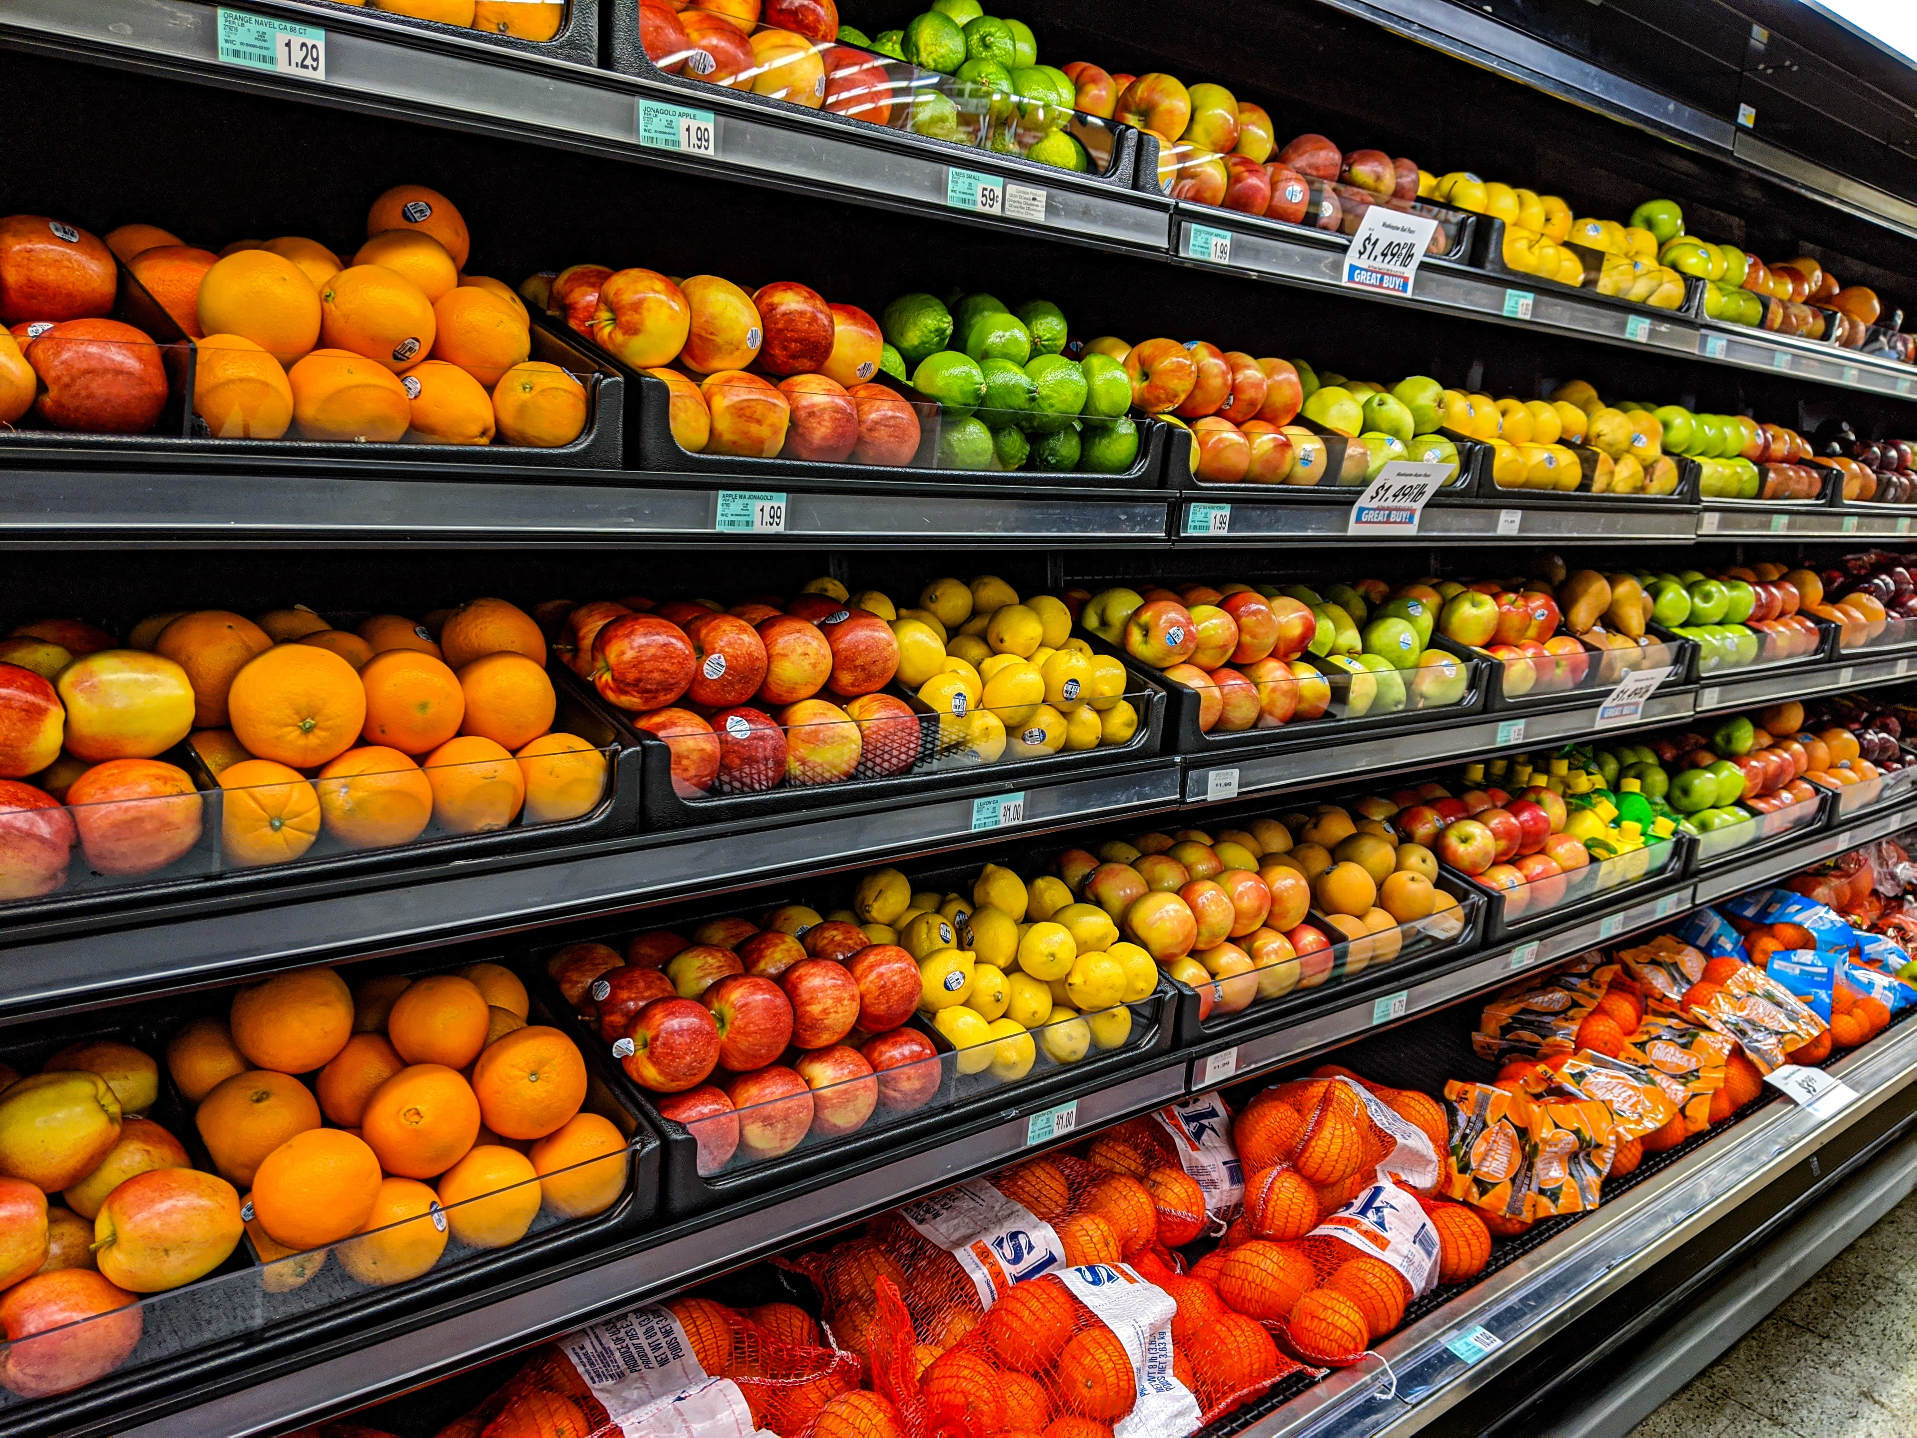
Kansas partners
Kansas Health Foundation
Sunflower Foundation
Kansas Alliance for Wellness
Kansas Rural Center
NetWork Kansas
Kansas Healthy Food Initiative
K-State Research and Extension Local Foods Transdisciplinary Team
State Agencies

Slide 25
Thank you!
Rural Grocery Initiative
rgi@ksu.edu
www.ruralgrocery.org

